Slide 1
How to Make an Eagle
Mohansic Lake - FDR State Park Yorktown, NY - October 2018 to August 2019
October 28 to December 28, 2018:
Return to Mohansic Lake (5 photos)
January 3 to February 17, 2019:
Love Birds (11 photos)
February 26 to April 12, 2019:
Sitting on the Eggs (22 photos)
April 15 to April 30, 2019:
Down-covered Baby Eaglets (16 photos)
May 2 to May 29, 2019:
The Eaglets Grow and Develop (13 photos)
June 1 to August 1, 2019:
The Eaglets Learn to Fly (23 photos)

Slide 2
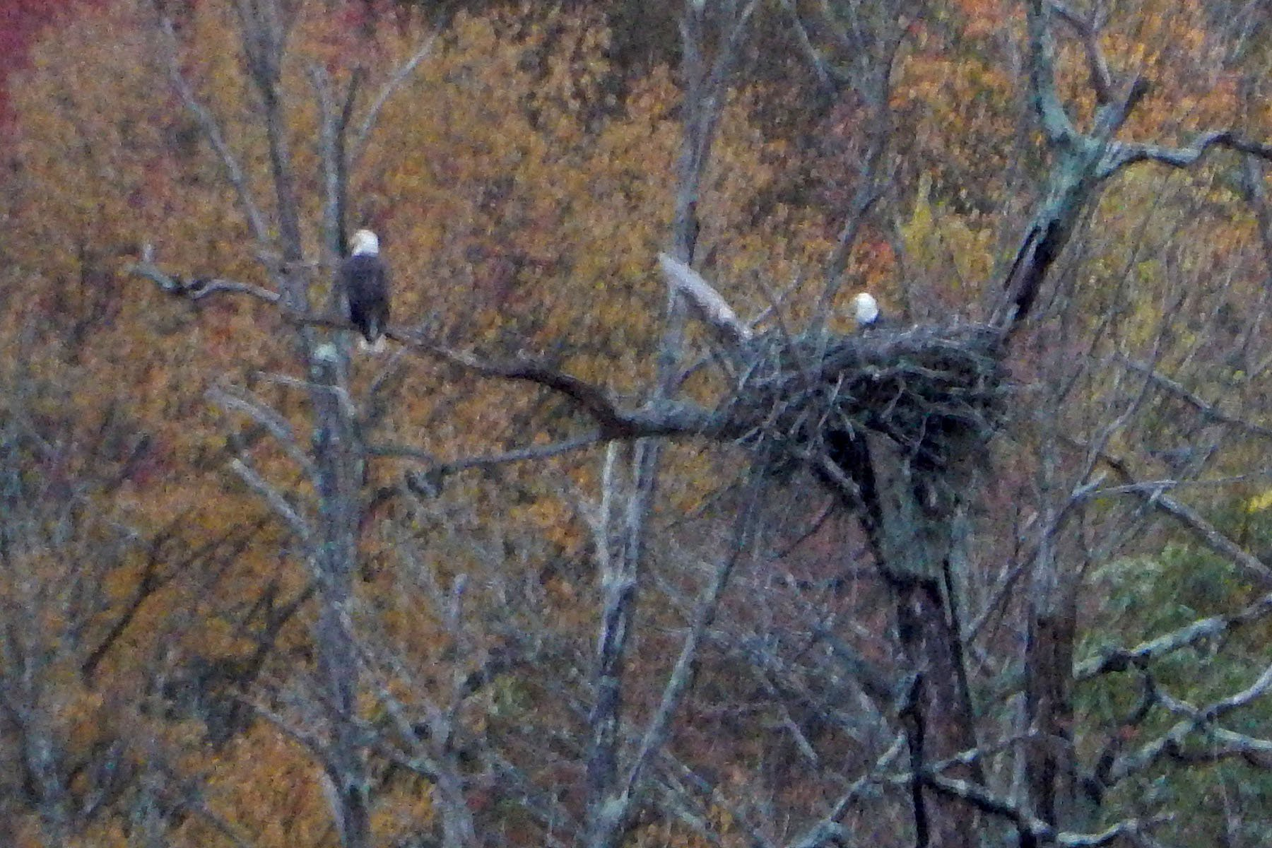
October 28, 2018:
Two Adult Eagles Arrive in FDR State Park
This was the first time any eagles were seen in FDR State Park since August 2, 2018.
The fall colors are fading in the background. These two adult eagles appear to be checking out the old nest which had been vacant since early August.
A single adult eagle was seen in this nest on October 31, 2018

Slide 3
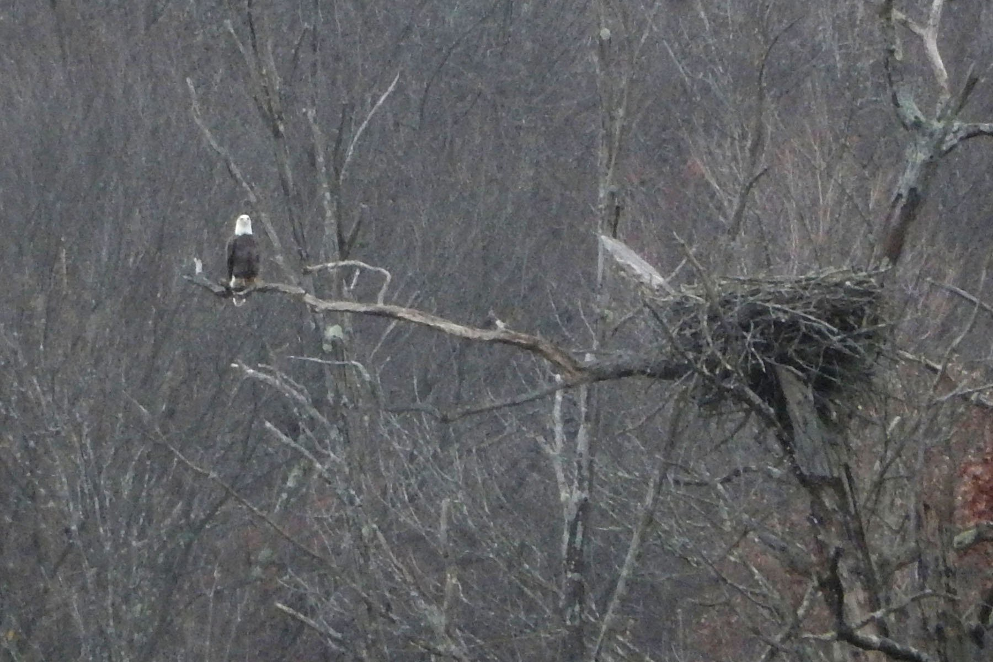
November 12, 2018: One Adult Eagle Near the Nest
This is one of five times one of the adult eagles was seen on the far side of Mohansic Lake during November 2019, including sightings on November 12, 13, 14, 18, and 24. In most of these cases, the eagle was not in or near the nest. Never more than one eagle was seen at any time in November.
An empty nest was observed on November 1, 2, 3, 4, 7, 11, 17, 22, 24, 25,
26, 27, and 29.

Slide 4
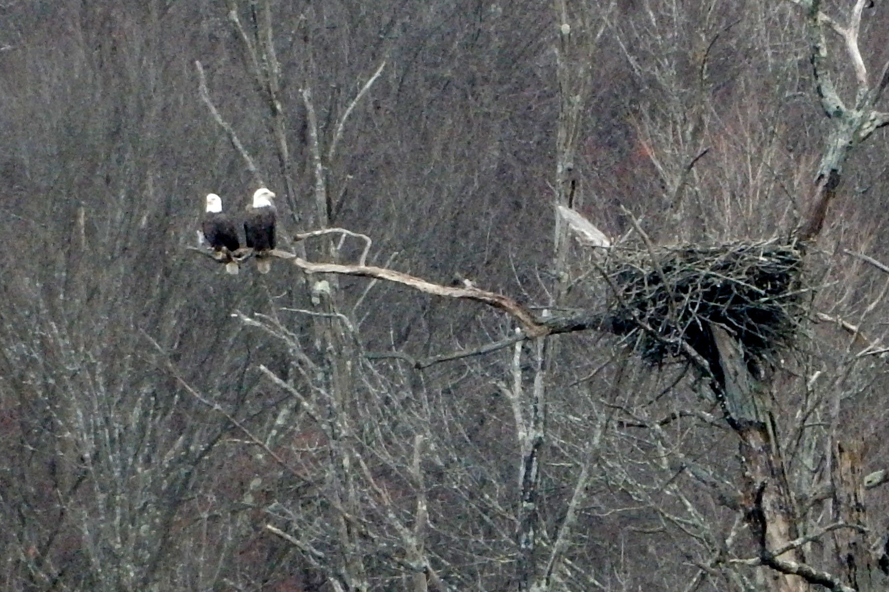
December 9, 2018: Love Birds
Unlike November, two adult eagles were seen close to one another many times during December 2018, including this example seen on December 9.
These eagles seem to be well aware of the importance of the nearby nest.

Slide 5
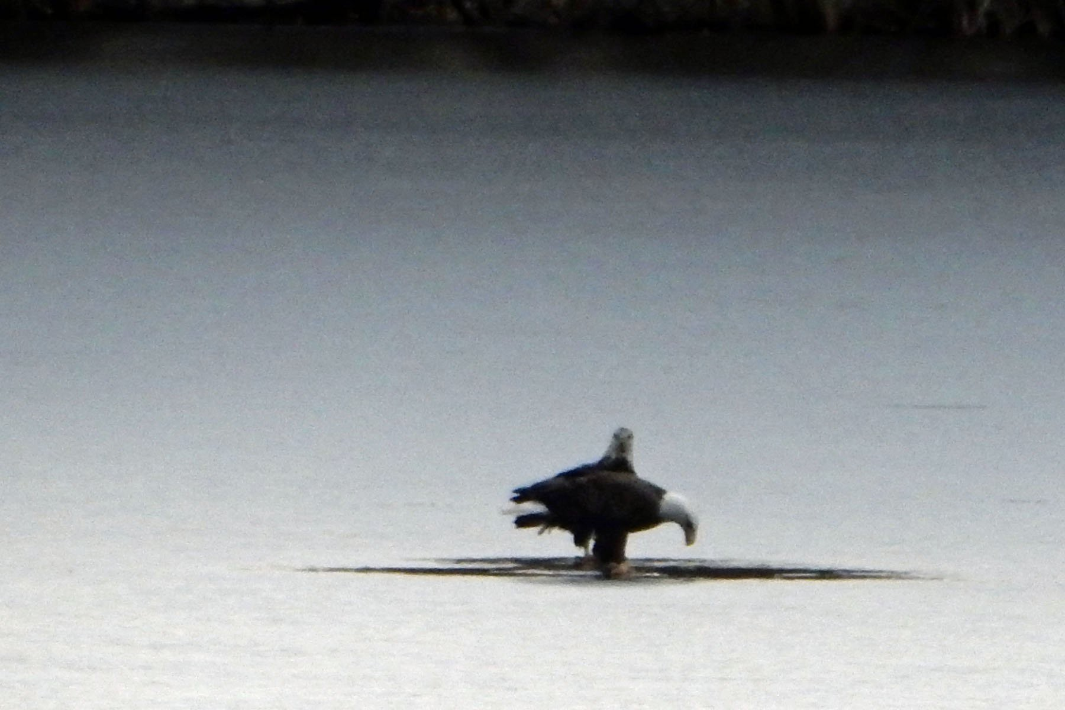
December 17, 2018: Frozen Mohansic Lake
This is one of seven photos of the adult eagles walking on the frozen surface of Mohansic Lake in December. The eagles stayed close together, but they were not happy.
At one point, one of them flapped its wings and rose a few feet into the air before folding its wings and dropping back onto the ice. It looked like it was trying to break through the ice, but it failed.

Slide 6
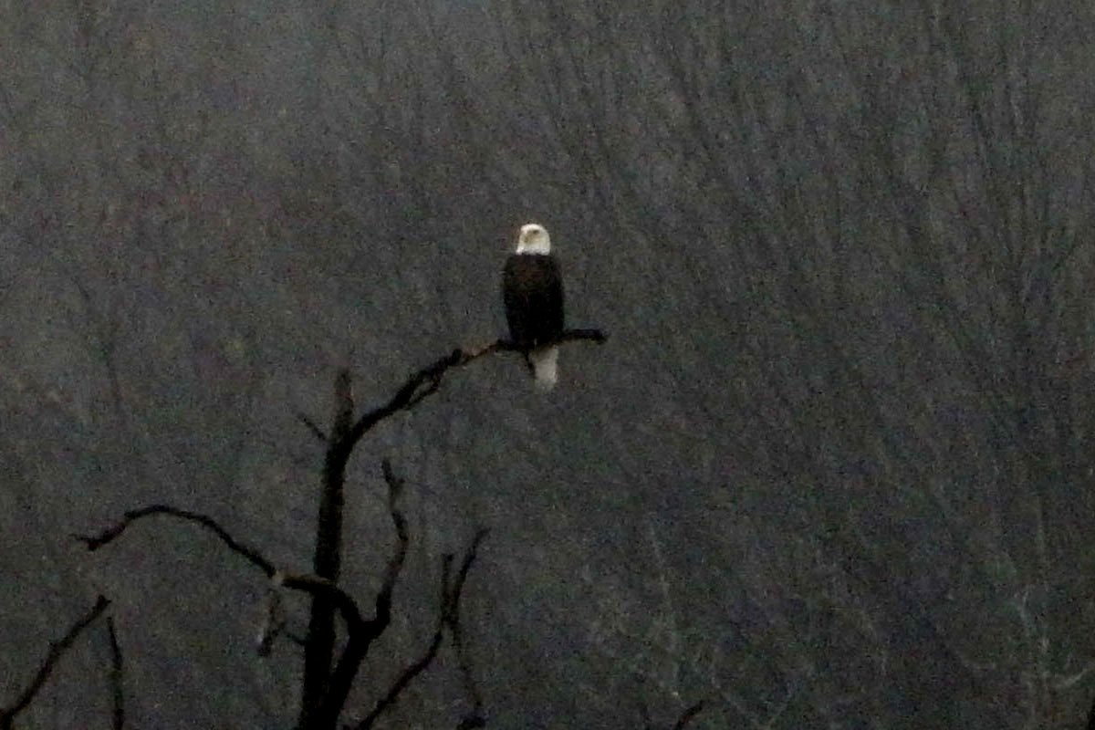
December 28, 2018: Eagle on a Perch
Although the two eagles frequently appeared together, sometimes they were seen perched solo. This photo was taken on a foggy day and it required adjustment of the brightness and contrast to pull the eagle out of the murky original photo.

Slide 7
How to Make an Eagle
Mohansic Lake - FDR State Park Yorktown, NY
January 3 to February 17, 2019:
Love Birds (11 photos)

Slide 8
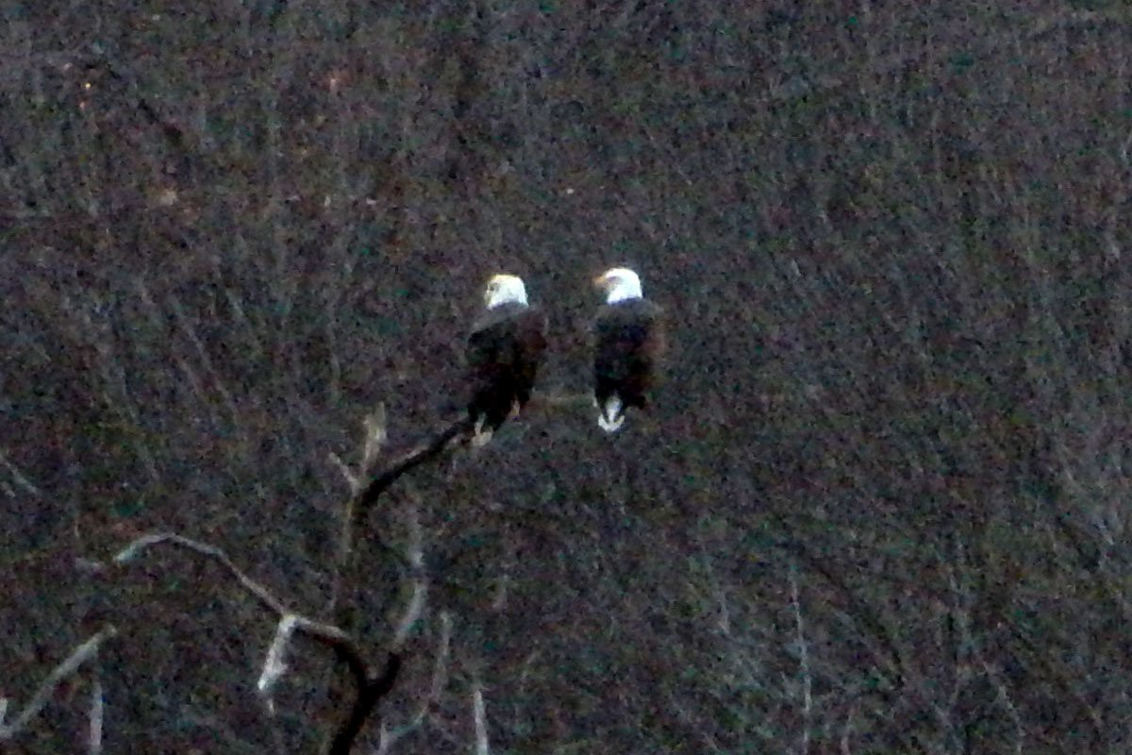
January 3, 2019: Love Birds
By January, these two adult eagles were spending a lot of time close together.

Slide 9
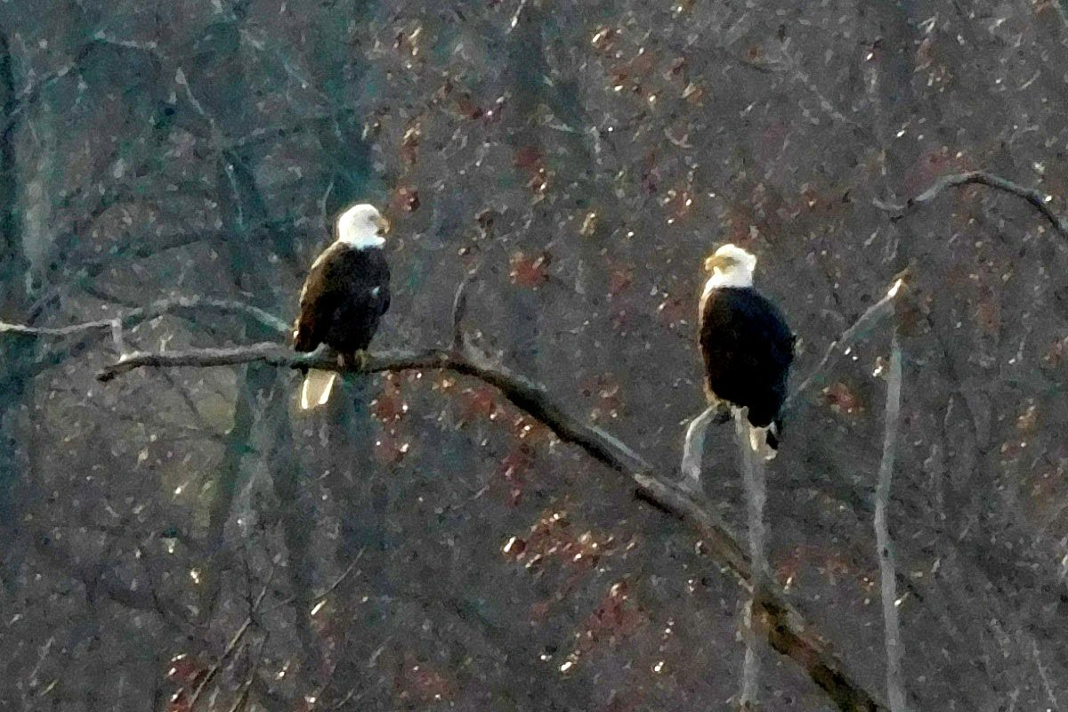
January 15, 2019: Love Birds
Two adult eagles are perched near each other while looking at each other.

Slide 10
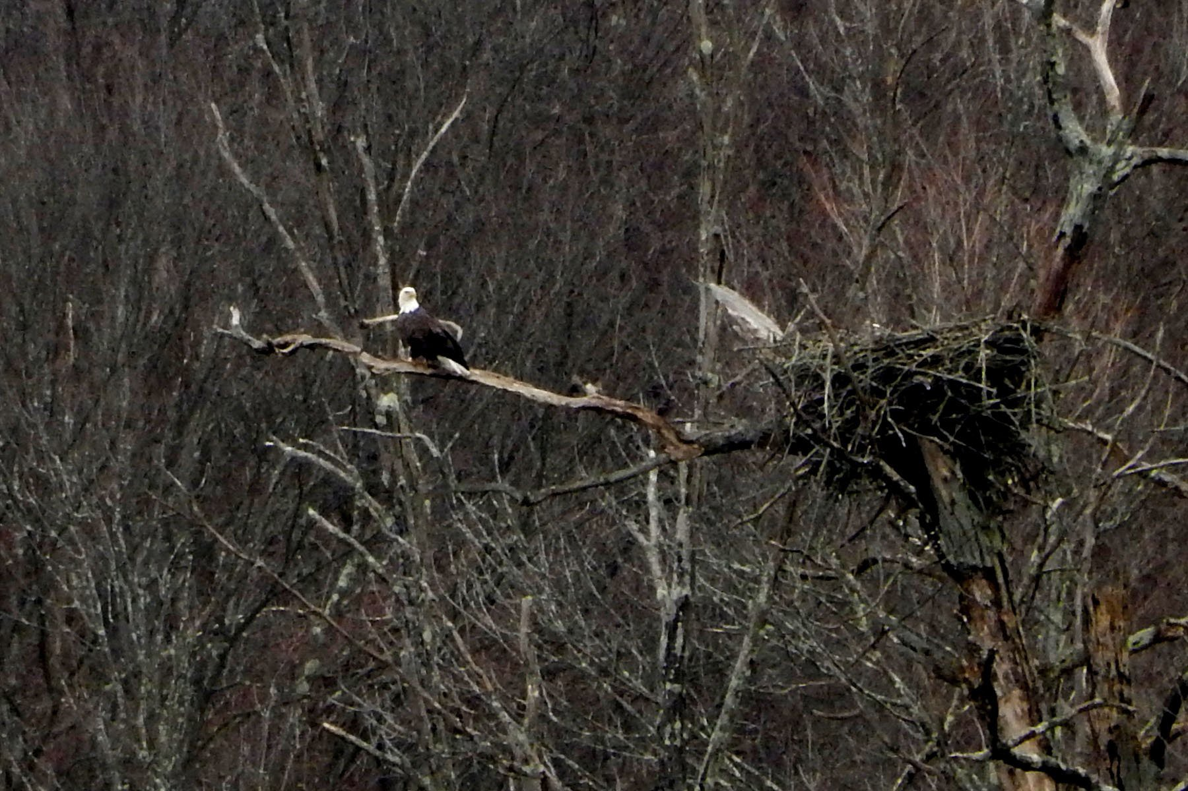
January 19, 2019 (2:45 PM):
One Adult Eagle Near the Nest
Although this eagle is not perched near its partner, it remains close to the nest.

Slide 11
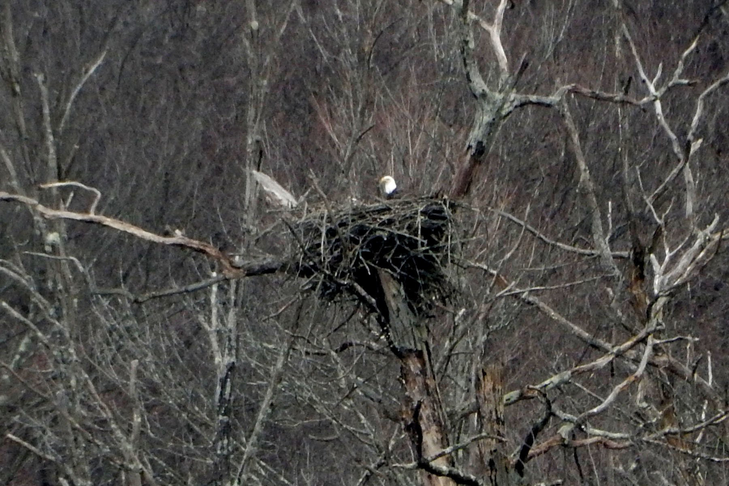
January 19, 2019 (2:46 PM):
One Adult Eagle in the Nest
The eagle previously seen near the nest has moved over to sit in the nest. This eagle is not very deep in the nest, since part of the eagle's dark body can be seen between its neck and the top of the nest. In later shots, the eagle will be found deeper in the nest.

Slide 12
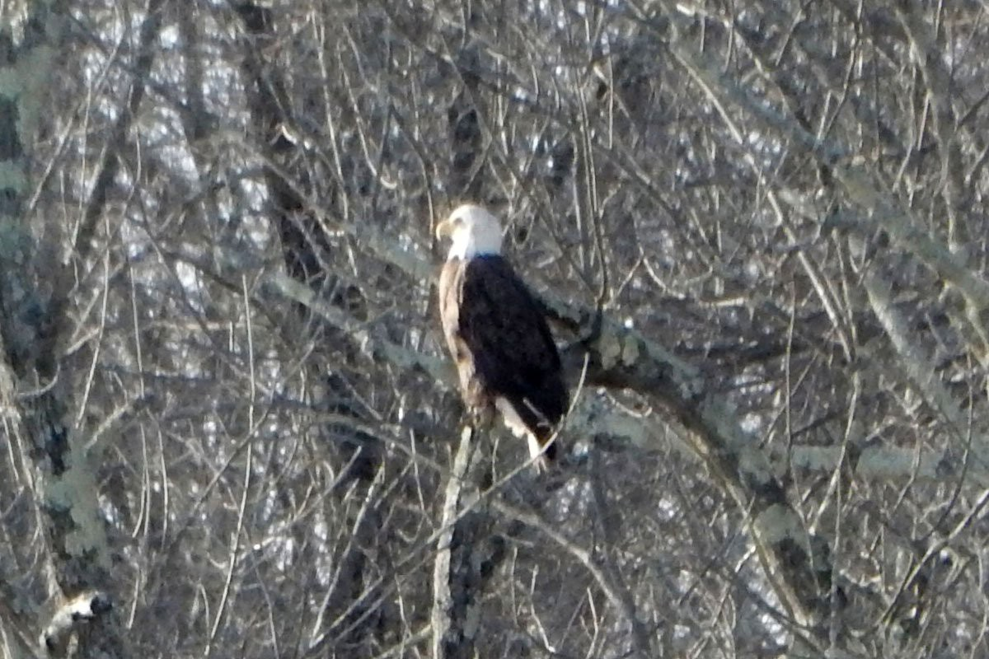
January 22, 2019: One Adult Eagle on the Near Side of Mohansic Lake
One or both adult eagles are seen most often near the eagles' nest. This nest is located on a peninsula on Mohansic Lake across the lake from a small parking lot near the bath house for the swimming pool for FDR State Park.
Occasionally, one or both adult eagles can be seen perched on trees on the near side of Mohansic Lake. These trees are much closer to the FDR bath house and allow the capture of better images of the eagles perched there.
This is an example of a photo of one of the eagles on the near side of Mohansic Lake.

Slide 13
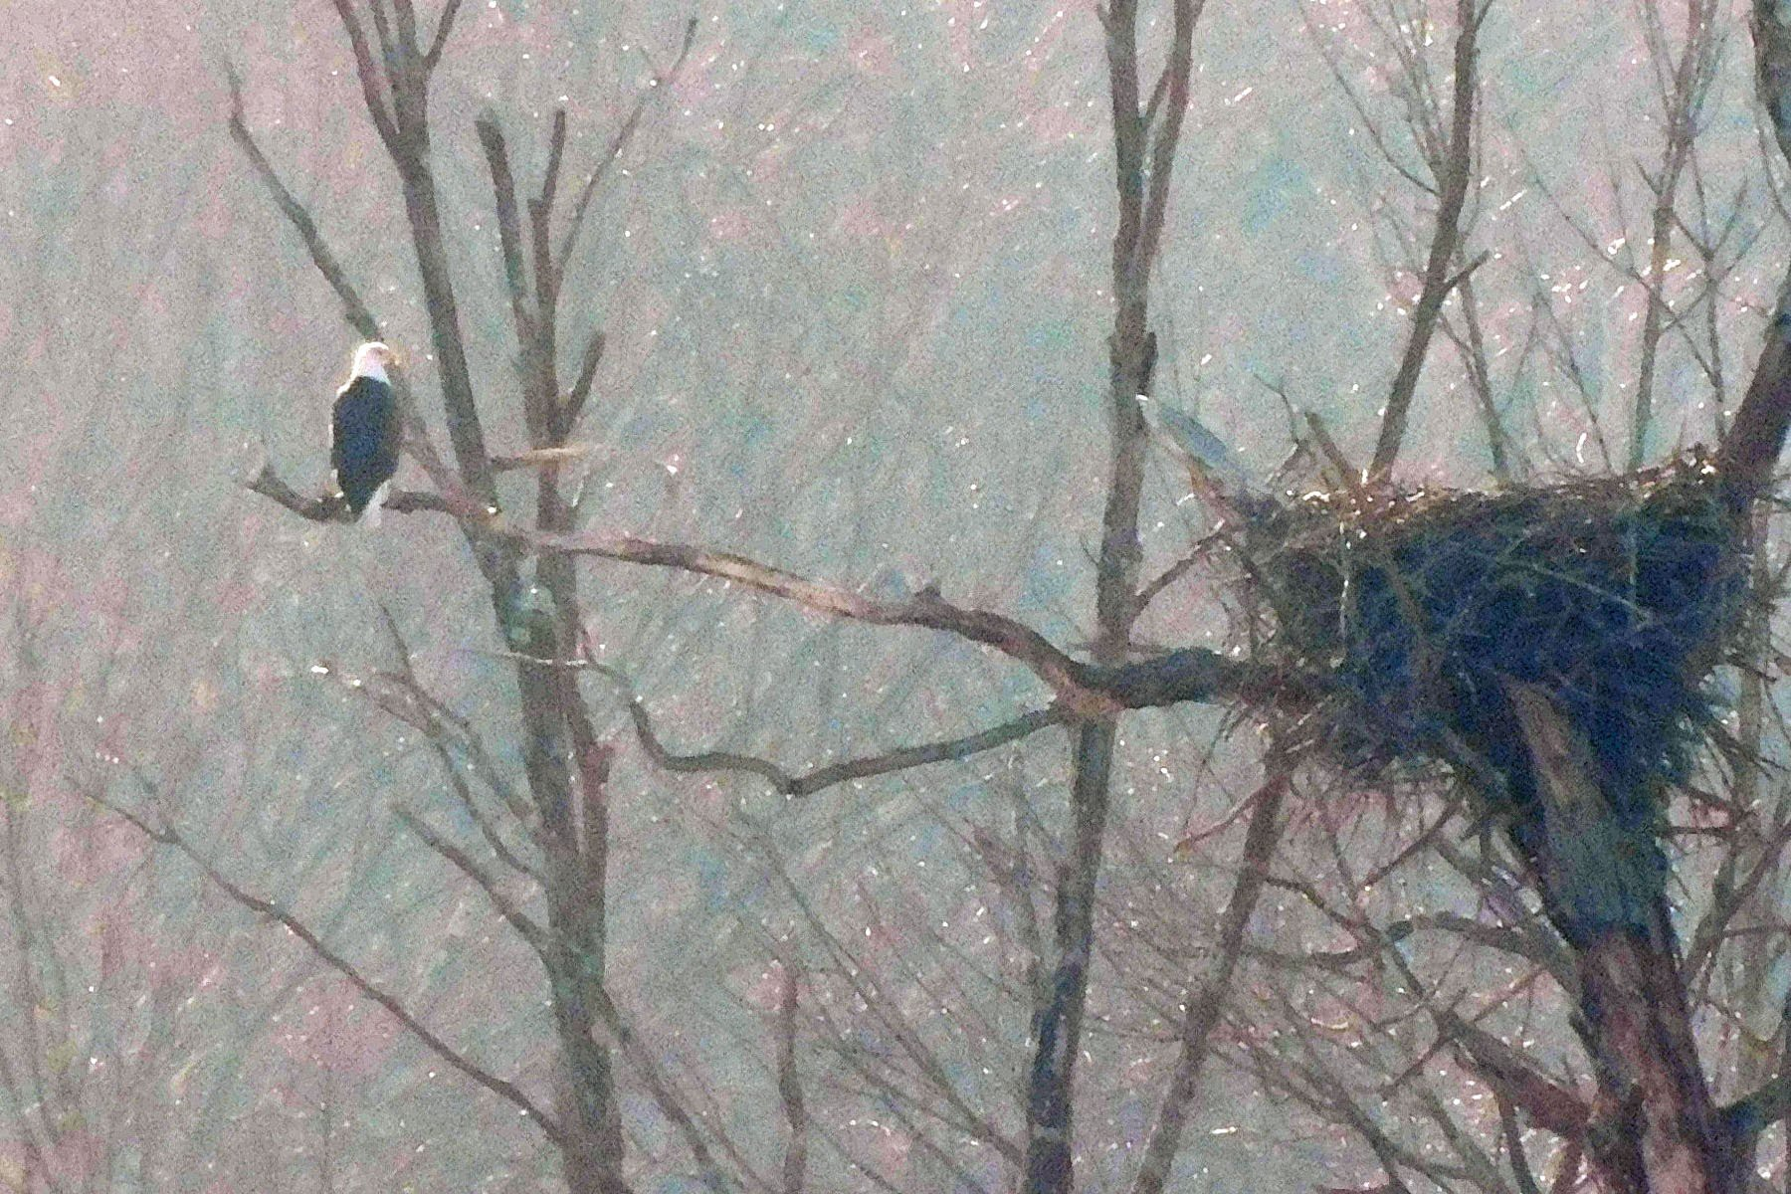
February 3, 2019: One Adult Eagle Near the Nest
This is another example of an adult eagle perched near the nest on a very foggy afternoon.

Slide 14
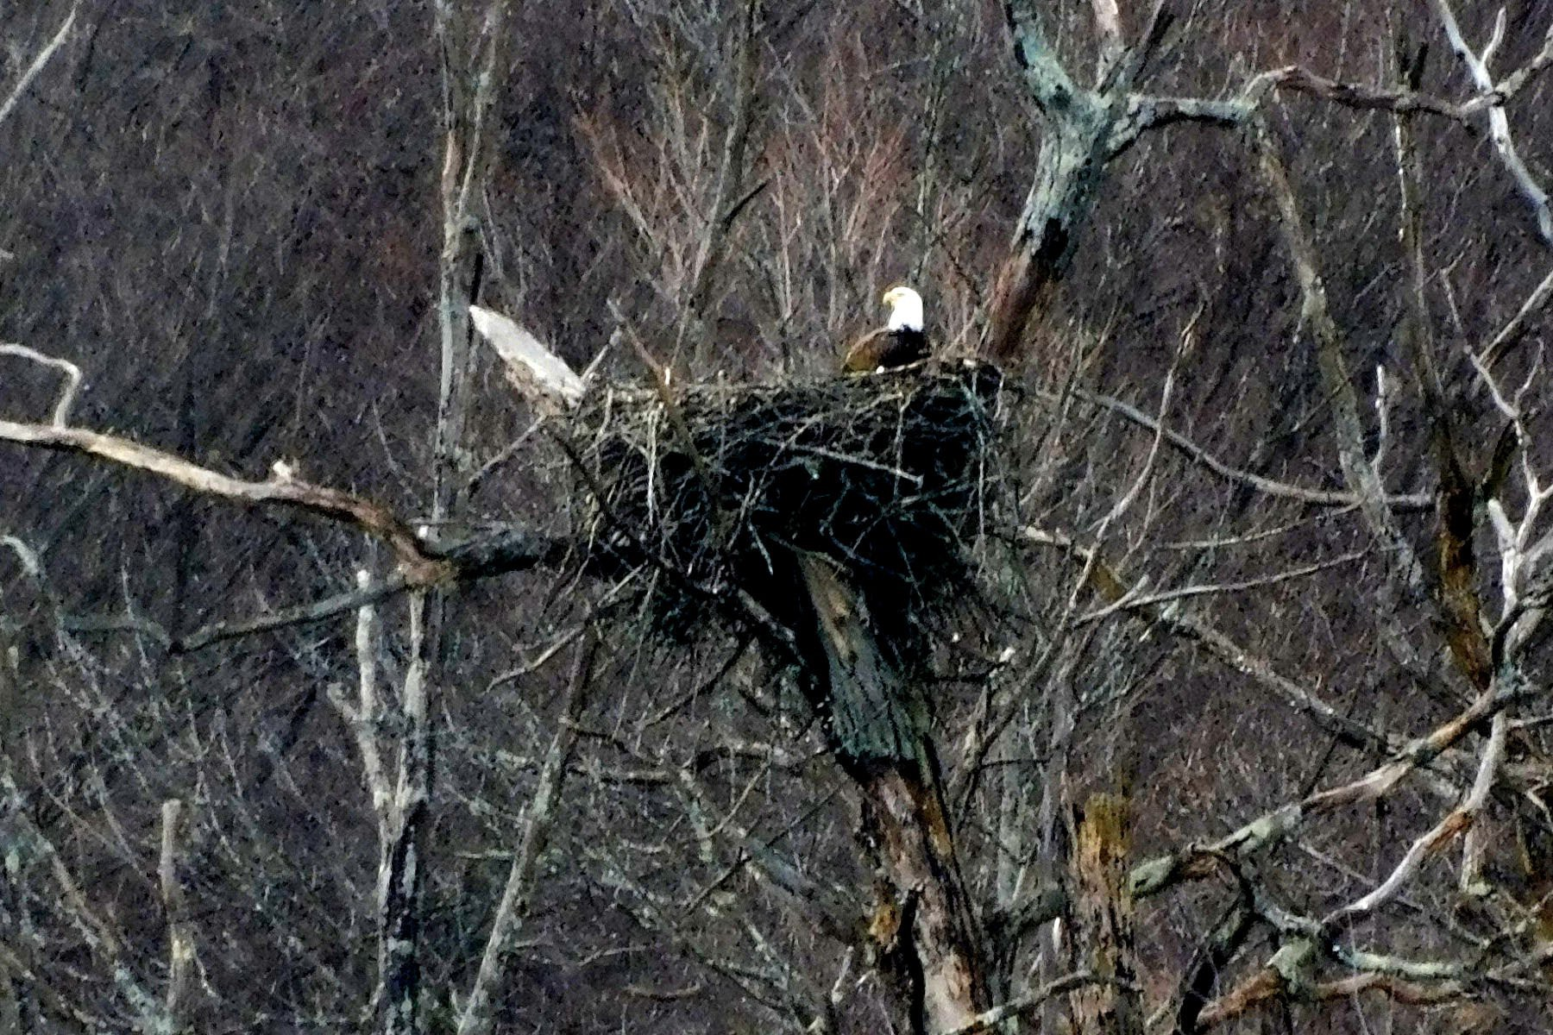
February 6, 2019: One Adult Eagle in the Nest
One adult eagle can be seen partially in the nest, allowing the white head, white neck, and part of the dark body to seen. This implies that this eagle is not yet sitting on eggs. The eagle will be seen deeper in the nest in later shots, while presumably sitting on eggs.

Slide 15
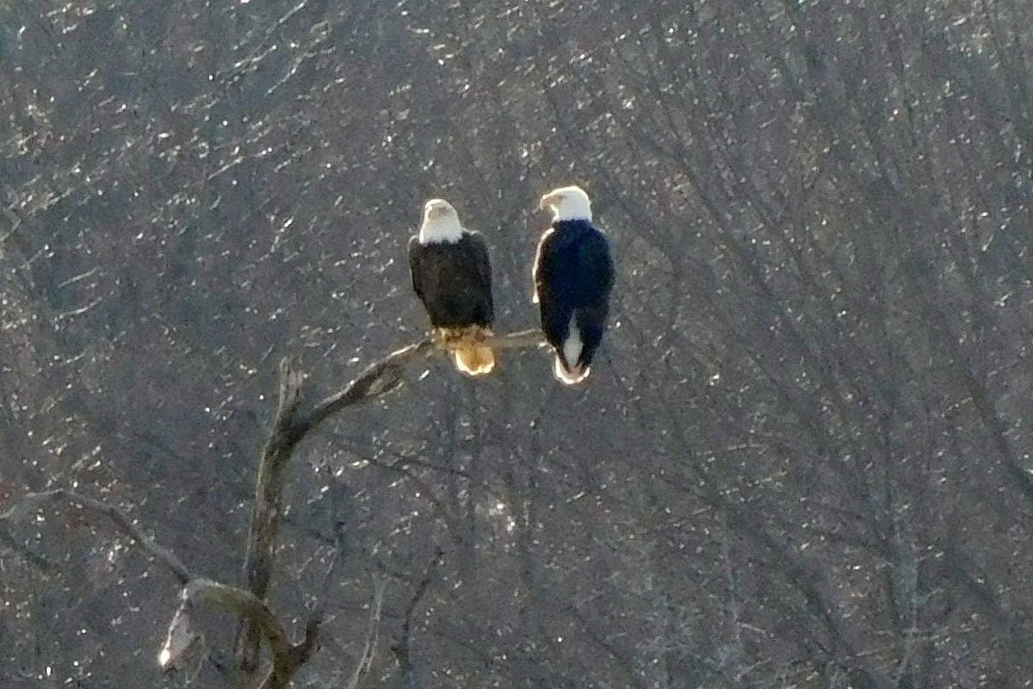
February 17, 2019 (3:17 PM): Love Birds 1
These two adult eagles are getting more serious, looking at each other while perched very close to each other.

Slide 16
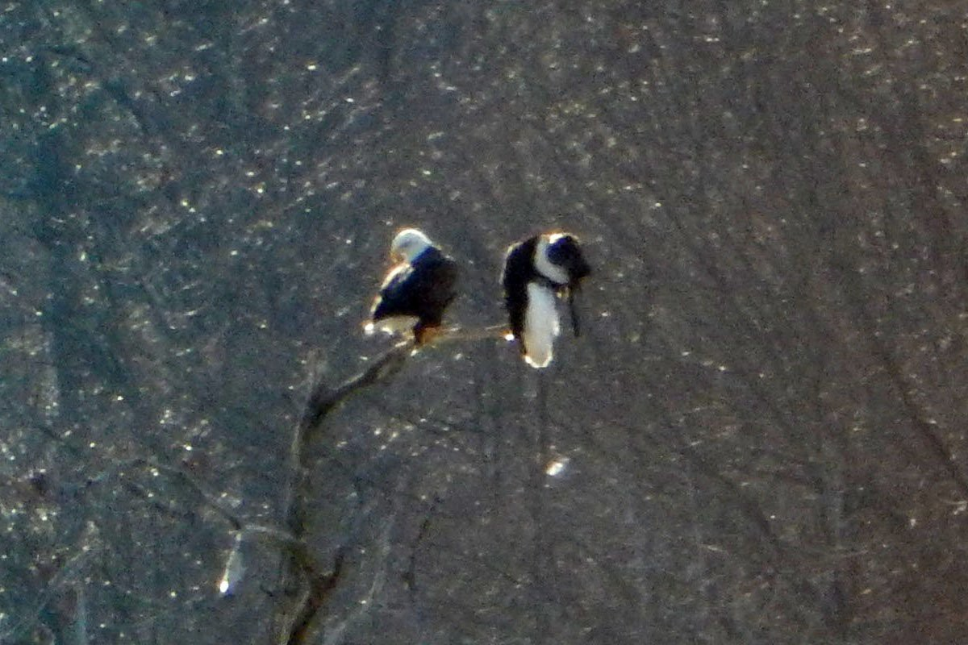
February 17, 2019 (3:19 PM): Love Birds 2
Something seems to have happened. The pair of eagles remain perched very close together, while the one on the right appears highly contorted.

Slide 17
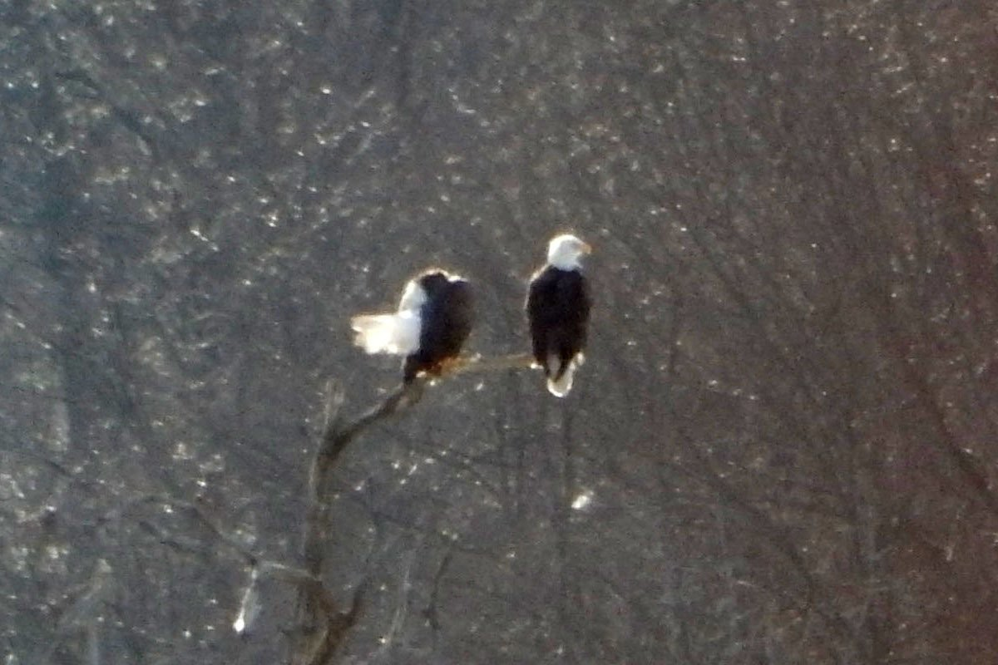
February 17, 2019 (3:19 PM): Love Birds 3
Something seems to have happened. The pair of eagles remain perched very close together, while the one on the left appears highly contorted.

Slide 18
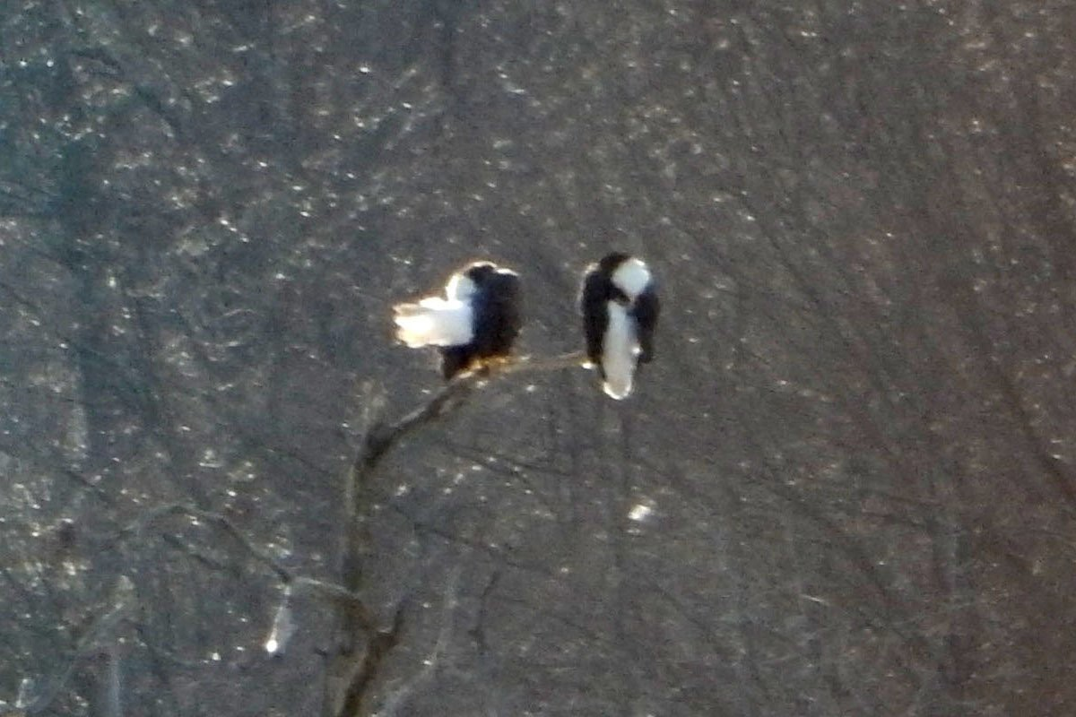
February 17, 2019 (3:19 PM): Love Birds 4
Something seems to have happened. The pair of eagles remain perched very close together, while both eagles appears highly contorted. Soon after this, one of these eagles heads to the nest where it will stay until a baby eaglet appears 8 weeks later on April 15,
This shows that these eagles must have been involved in whatever activities were needed in order for two baby eaglets to hatch from eggs a few weeks later.

Slide 20
How to Make an Eagle
Mohansic Lake - FDR State Park Yorktown, NY
February 26 to April 12, 2019:
Sitting on the Eggs (22 photos)

Slide 21
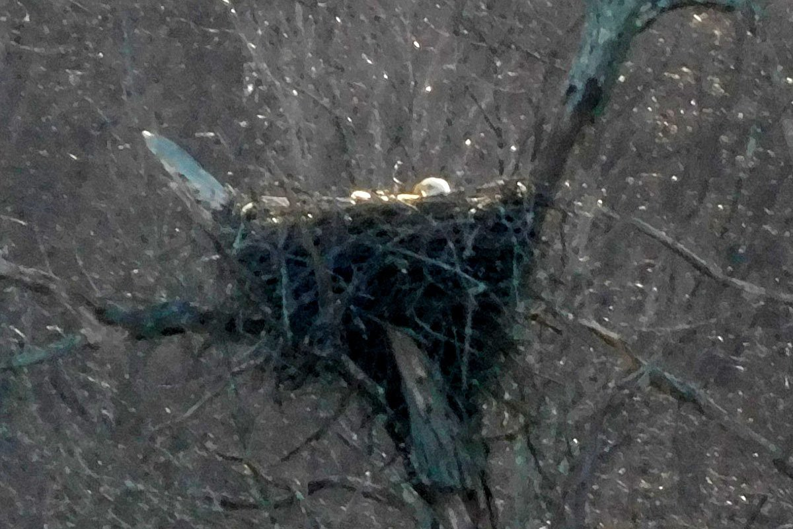
February 26, 2019:
One Adult Eagle Sitting Deep in the Nest
This eagle is sitting much deeper in the nest than seen before, with only part of the head visible above the nest. This eagle may be either laying eggs or sitting on recently laid eggs.

Slide 22
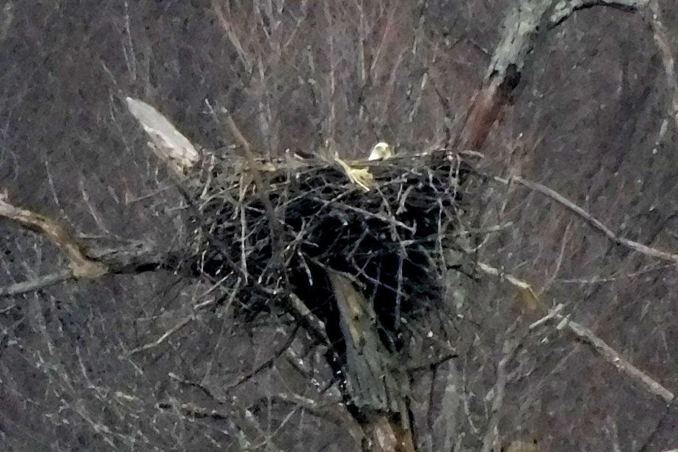
March 3, 2019: An Adult Eagle Sitting Deep in the Nest
An adult eagle is sitting deep within the nest, watching the camera. Within 24 hours, this nest will be covered with snow.

Slide 23
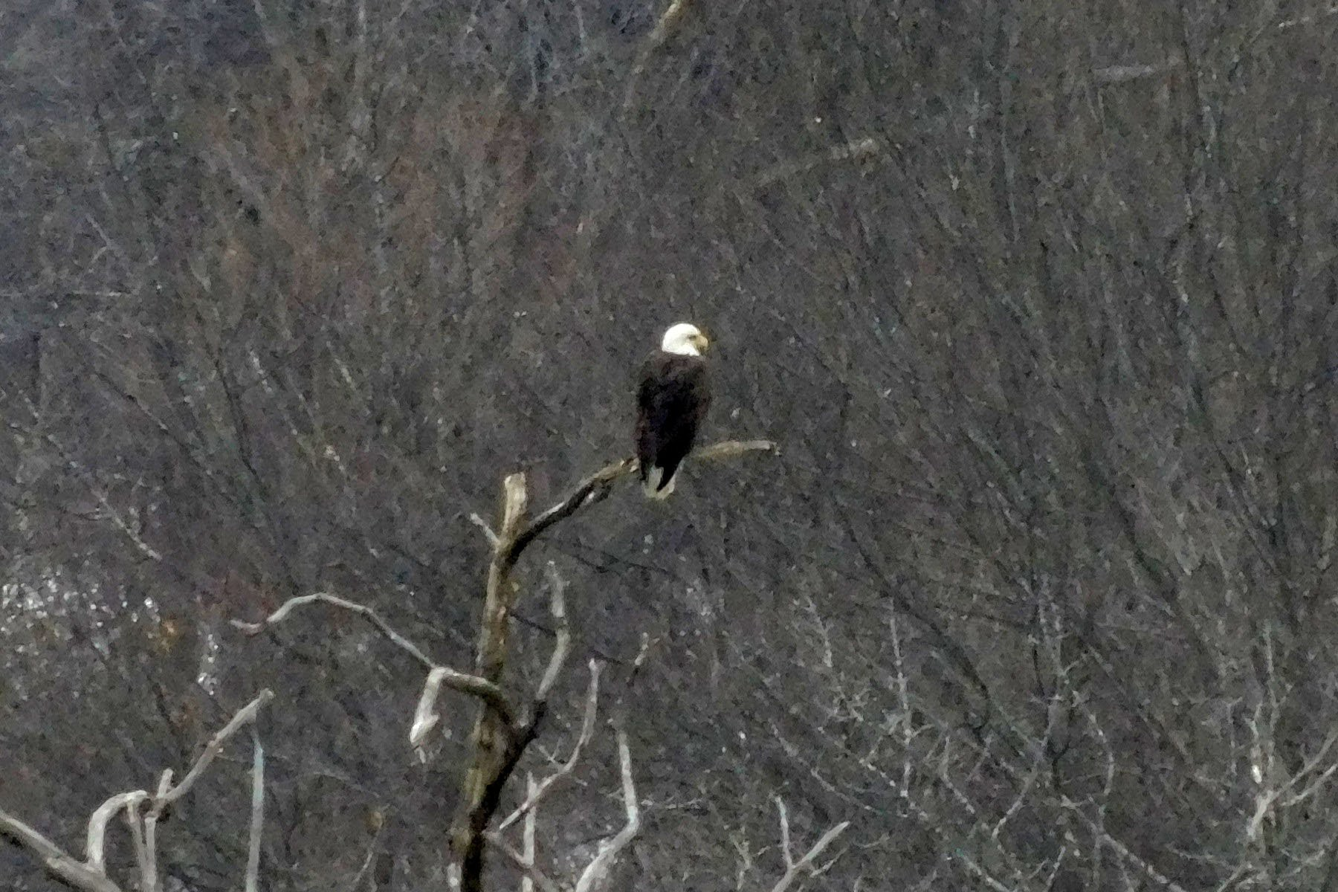
March 3, 2019: An Adult Eagle Perched on a Tree
The second adult eagle (the father?) is perched on a tree near the nest. Within 24 hours, the nest will be covered with snow. Do these eagles have any sense of the impending changes in the weather?

Slide 24
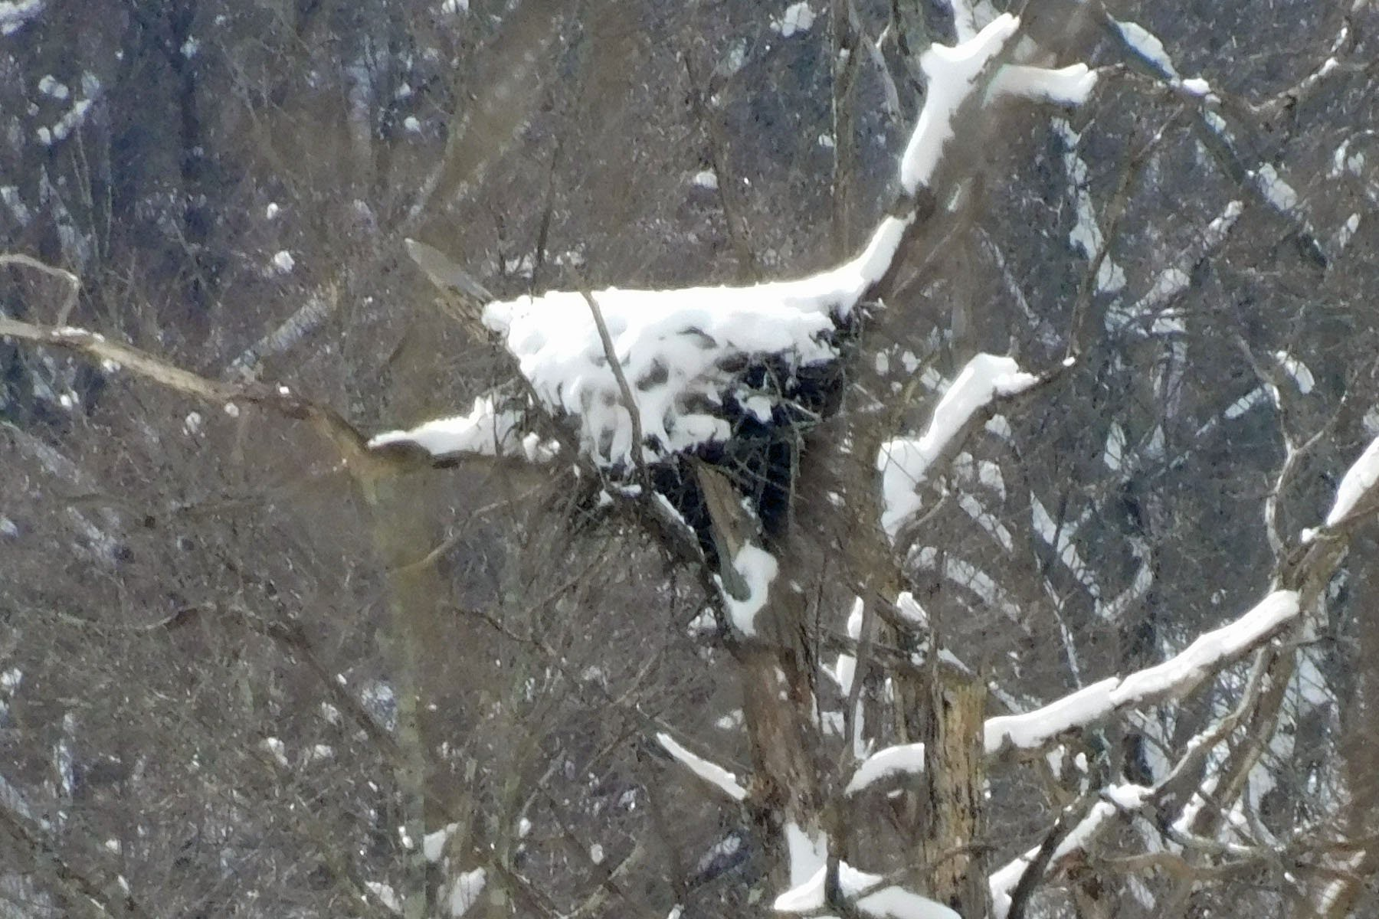
March 4, 2019: Snow Covered Nest 1
We had several inches of wet sticky snow over the evening of March 2-3, 2019. This is what we found the next day. One adult eagle (the mother?) was enclosed in an igloo of snow along with a clutch of eggs.
We cannot see the eggs in this or any other photos, but we know they must be there because baby eaglets began to appear in the nest by April 15.

Slide 25
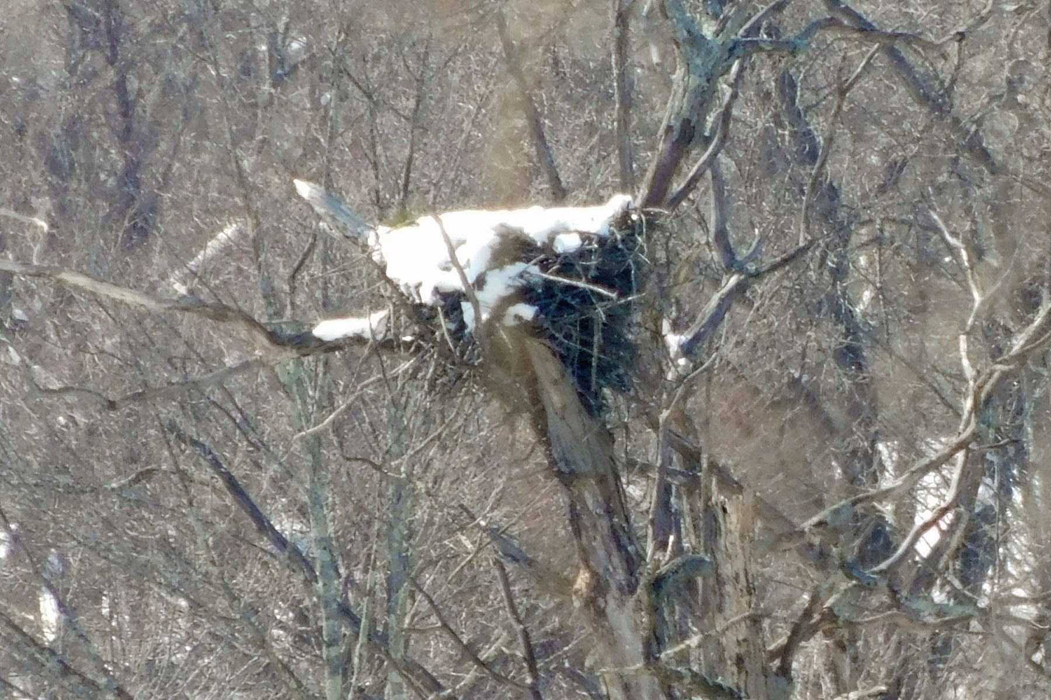
March 5, 2019: Snow Covered Nest 2
On the second day after the snow fall, some snow has melted, and a hatchway seems to have opened in the upper left corner of the igloo.

Slide 26
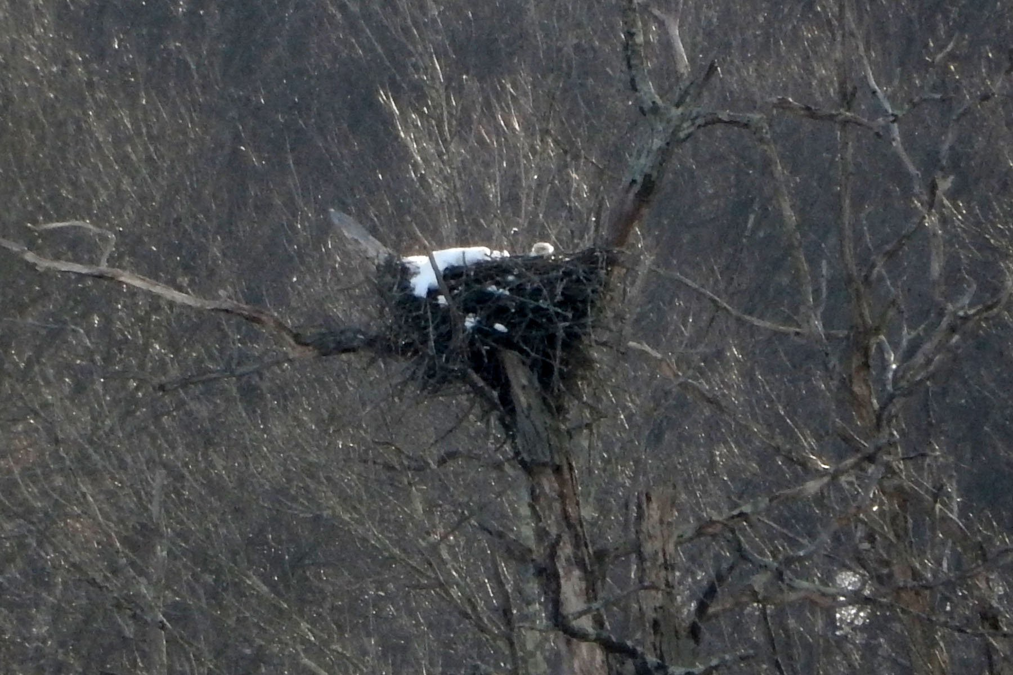
March 6, 2019: Snow Covered Nest 3
On the third day after the snow fall, most of the snow has melted, and the occupant of the igloo can be seen for the first time. This eagle (the mother?) remains deep in the nest, possibly sitting on a pair of eggs.

Slide 27
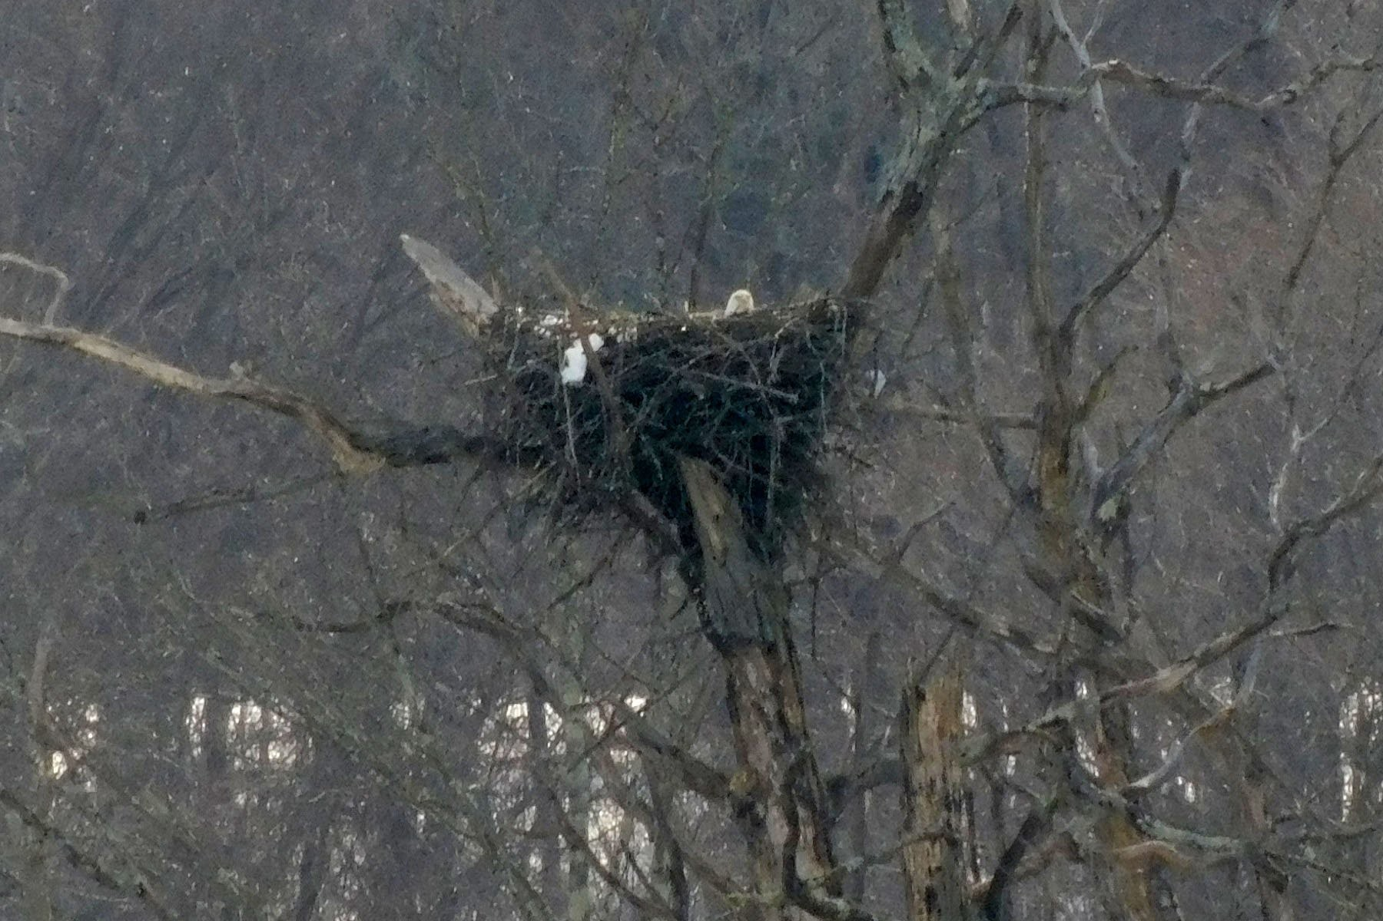
March 8, 2019: Snow Covered Nest 4
One of the adult eagles remains deep in the nest after nearly all of the snow has melted.

Slide 28
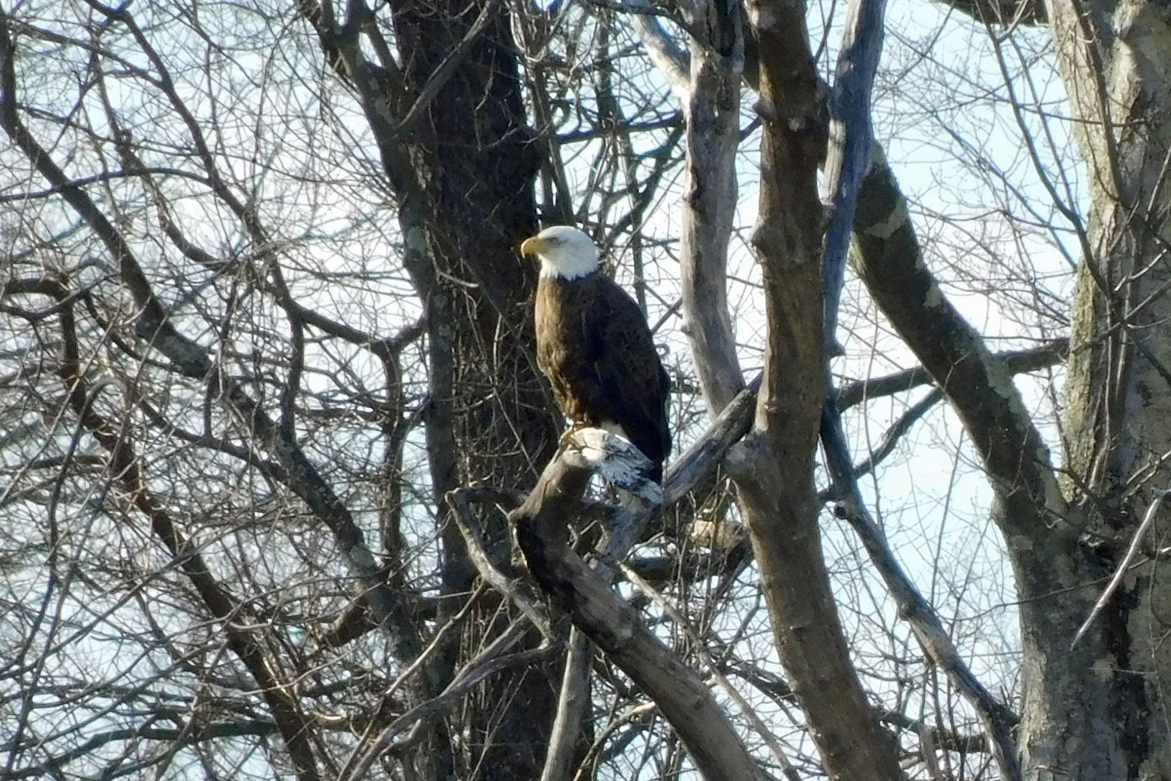
March 12, 2019:
One Adult Eagle on the Near Side of Mohansic Lake
This is similar to the scene captured on January 22. This is the best photo yet of one of this pair of adult eagles.

Slide 29
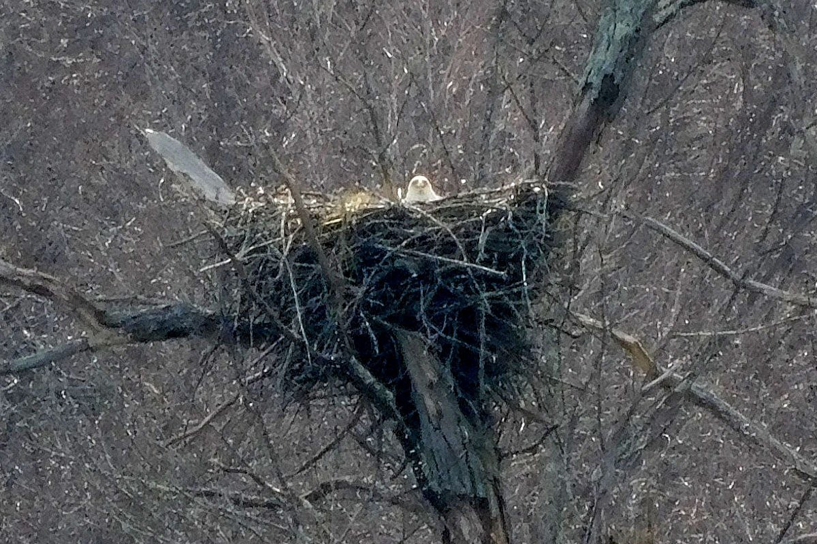
March 25, 2019: One Adult Eagle Camera
Watching
the
The sharp eyes of this eagle appear to know where the camera is located. This eagle remains deep in the nest and likely to be sitting on a pair of eggs.

Slide 30
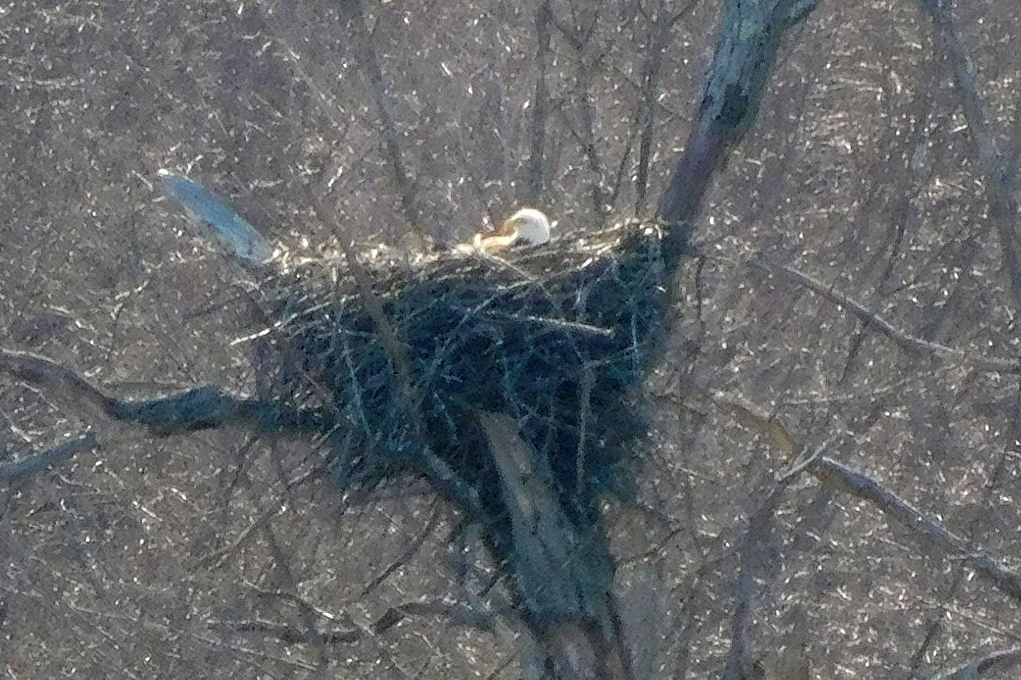
March 26, 2019: One Adult Eagle Resting Low in the Nest
One adult eagle can be seen resting low in the nest. It is probably sitting on or near a pair of eggs.

Slide 31
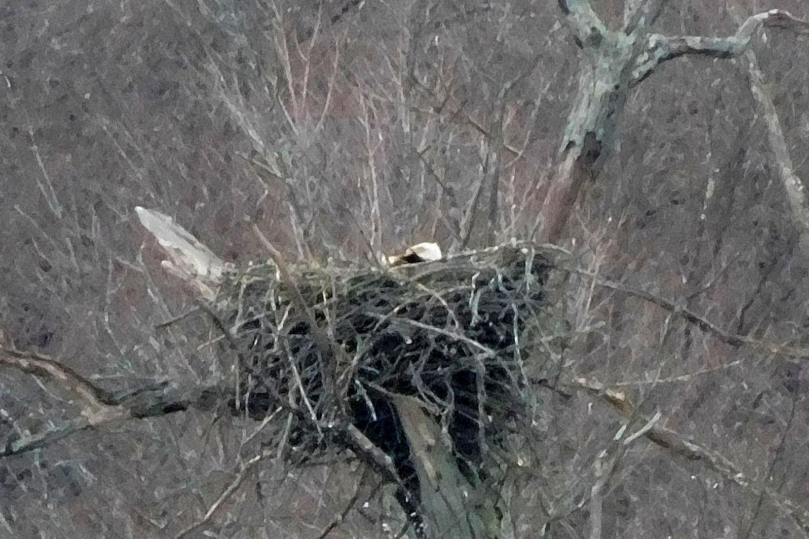
March 31, 2019: One Adult Eagle Resting Low in the Nest
This is another shot of one adult eagle resting low in the nest. It is probably continuing to sit on or near a pair of eggs.

Slide 32
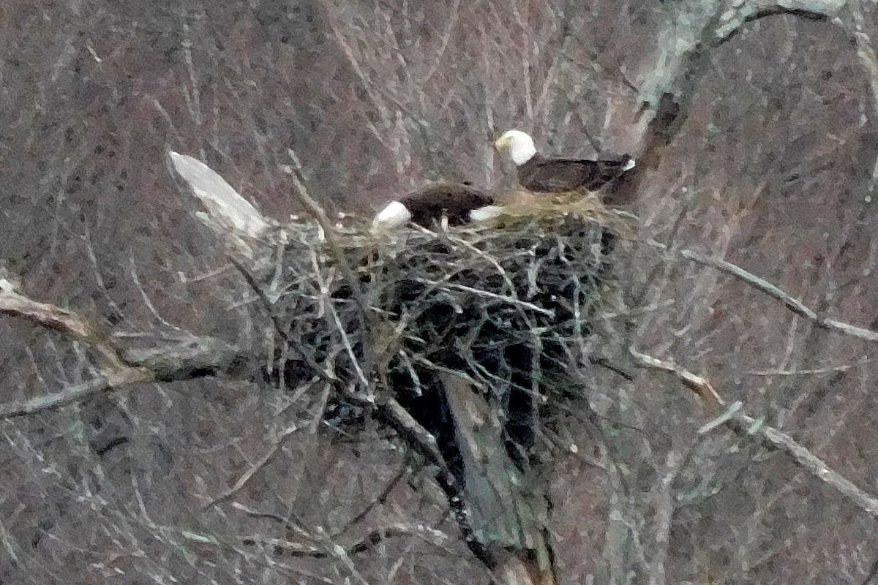
April 2, 2019: Two Adult Eagles on the Nest
Both adult eagles can be seen on top of the nest. They appear to be in the process of trading places so the eagle that had been sitting on the eggs can fly away and find some food for itself. The other eagle will then take its place sitting on the eggs in the nest.
Adult eagles are known to share the responsibility for sitting on their eggs.

Slide 33
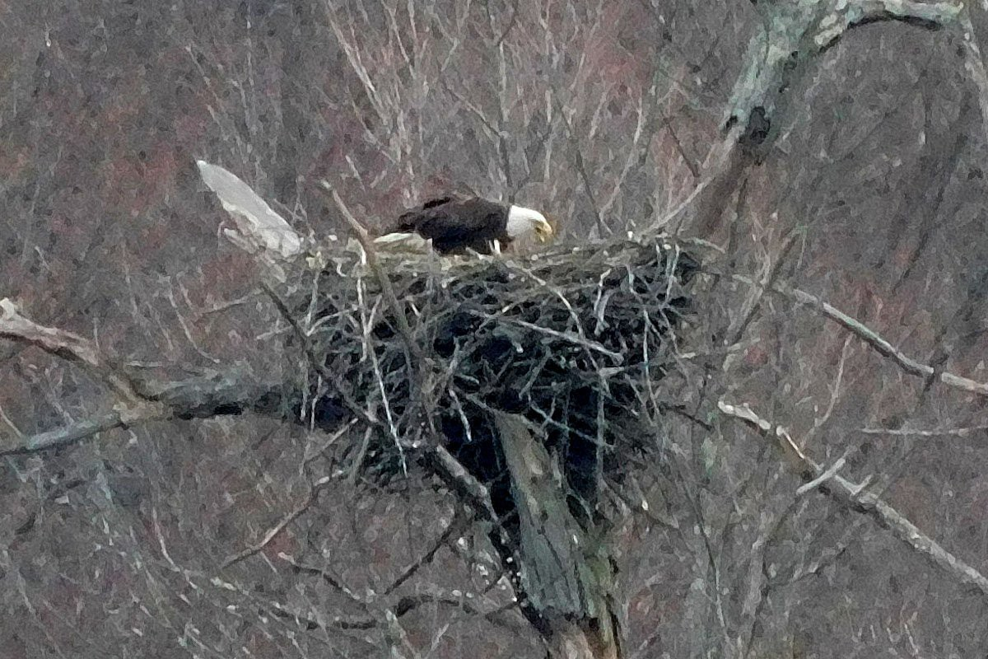
April 7, 2019:
One Adult Eagle on the Nest with its Beak Open
This eagle is on the nest with its beak open. It is not clear why its beak is open. It is probably making some noise, but it was too far away to be heard. The other adult eagle may be hidden low in the nest.
This eagle may be telling its partner to get out and let it take over sitting on the eggs. Or it is possible that one of the eggs has hatched and the hatchling eaglet cannot be seen because it is too small and too deep in the nest.

Slide 34
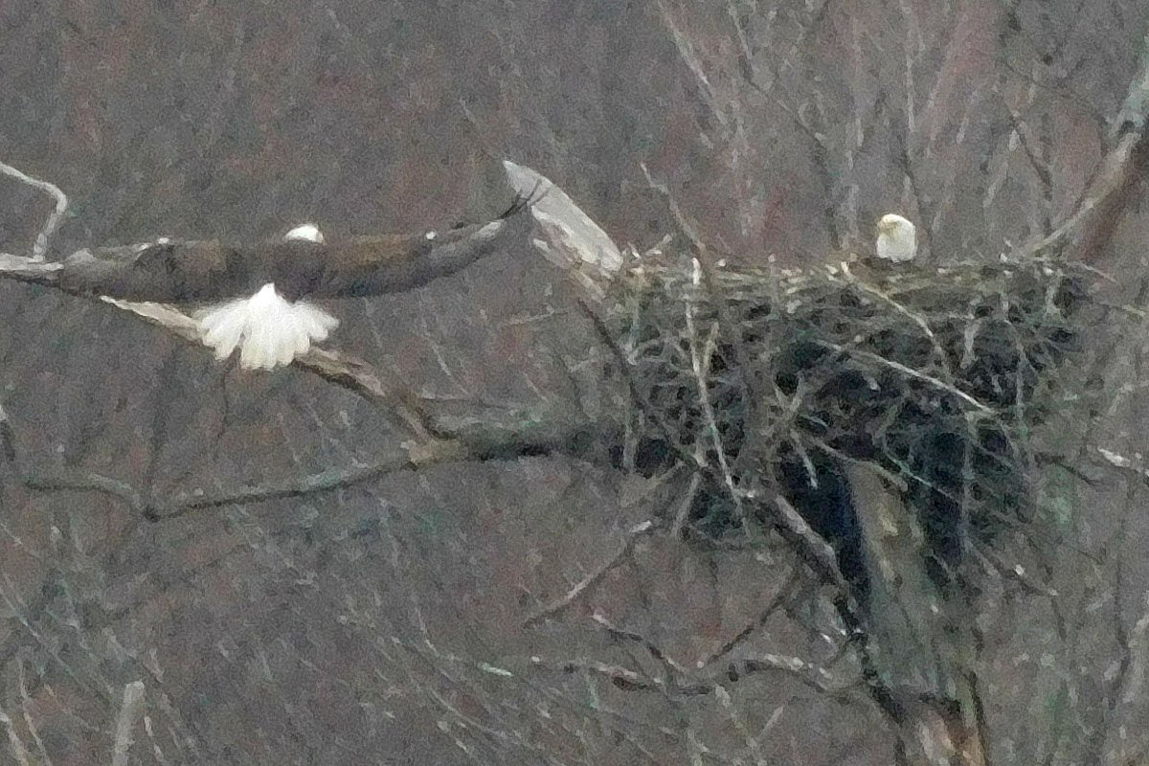
April 9, 2019: Second Adult Eagle Arriving at the Nest
One adult eagle can be seen deep in the nest while its partner arrives on the wing. The two adult eagles will trade places after the partner lands on the nest.

Slide 35
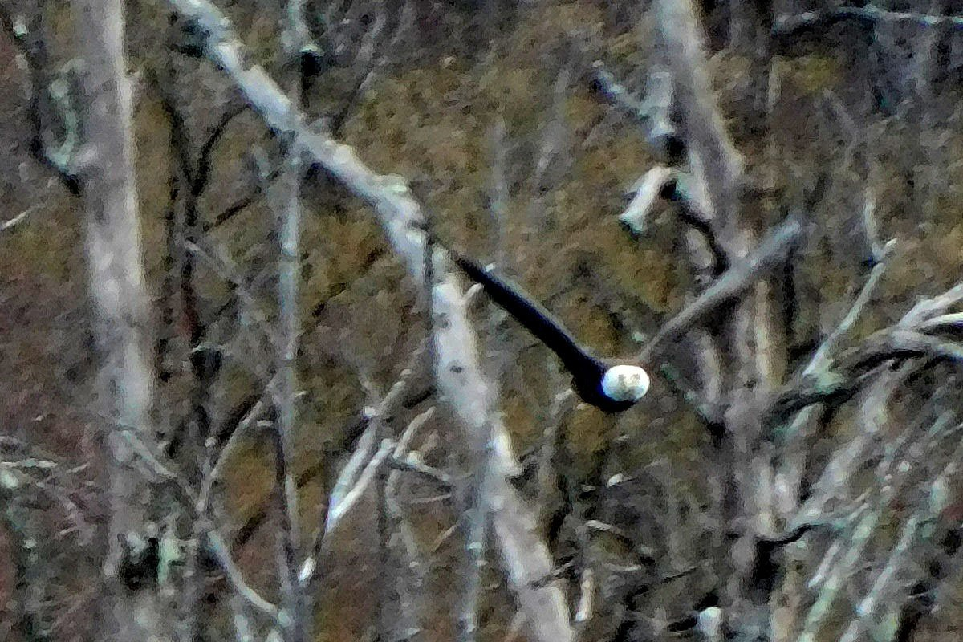
April 11, 2019 (5:20 PM): One Adult Eagle in Flight
This adult eagle is returning to the nest after foraging for food.

Slide 36
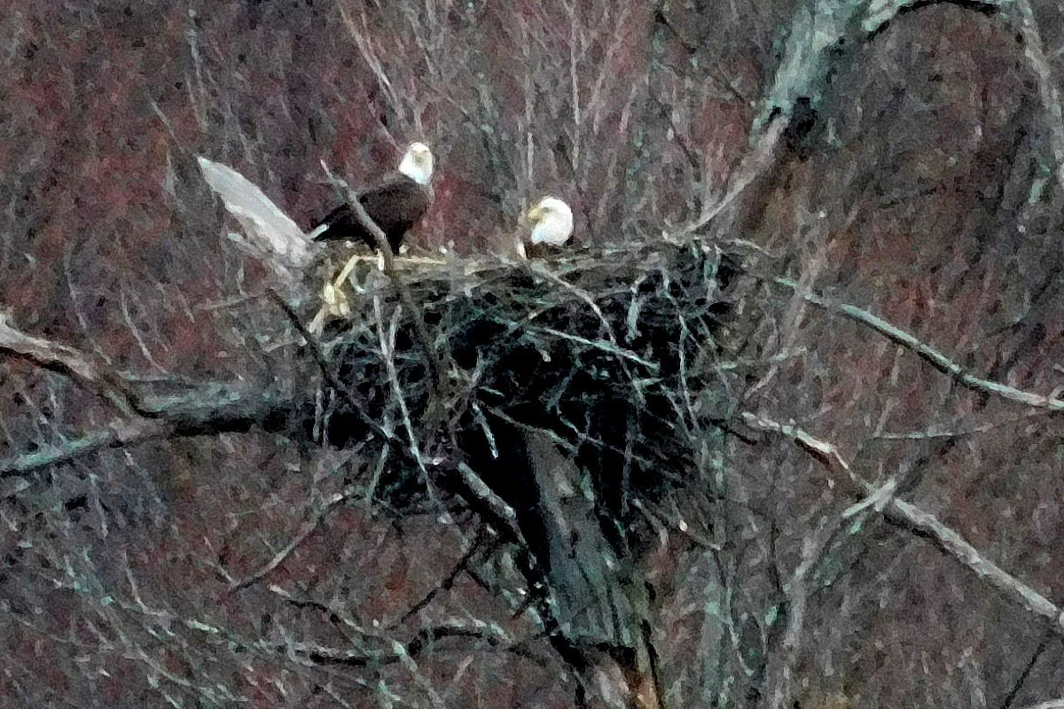
April 11, 2019 (5:26 PM):
Two Adult Eagles, One on the Nest and One in the Nest
After arriving at the nest, one eagle stares at the camera while its partner continues to sit on the eggs in the nest. The eyes of the eagles are better than the lens on this camera..

Slide 37
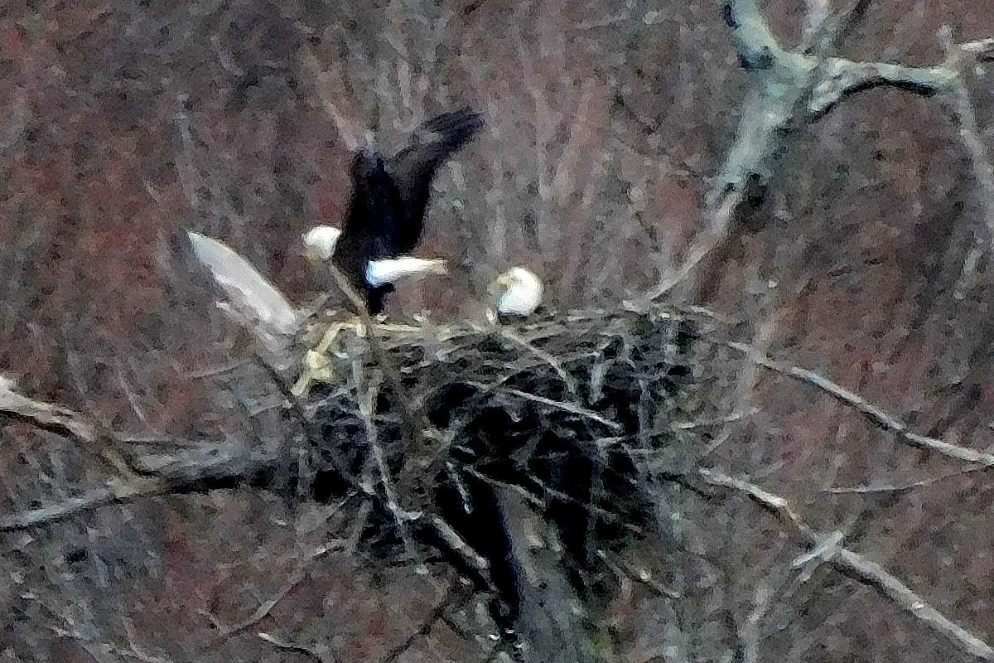
April 11, 2019 (5:26 PM):
Two Adult Eagles, One on the Nest and One in the Nest
One eagle is sitting low in the nest. It is probably sitting on the eggs. The other eagle is preparing to take off. These eagles may have traded places after one of them arrived a few minutes ago.

Slide 38
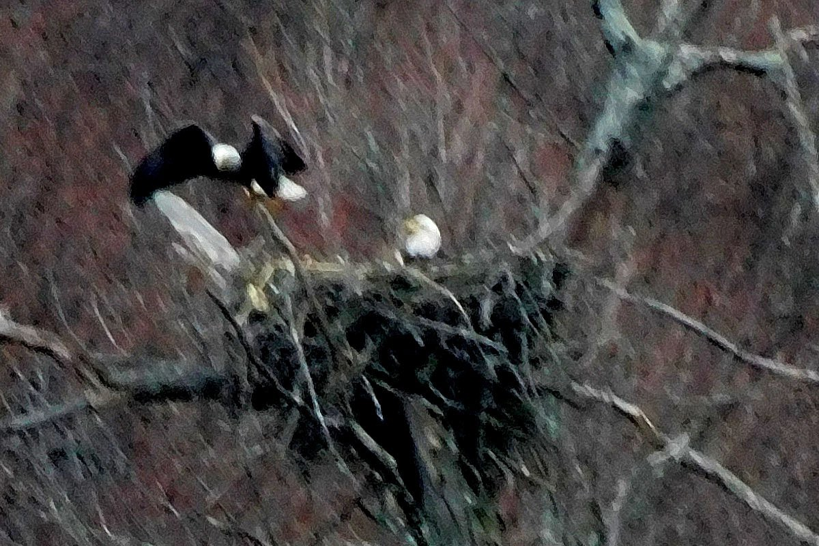
April 11, 2019 (5:26 PM): Two Adult Eagles, One in the Nest and One Leaving the Nest
One eagle is sitting low in the nest. It is probably sitting on the eggs. The other eagle has just taken off to leave the nest.

Slide 39
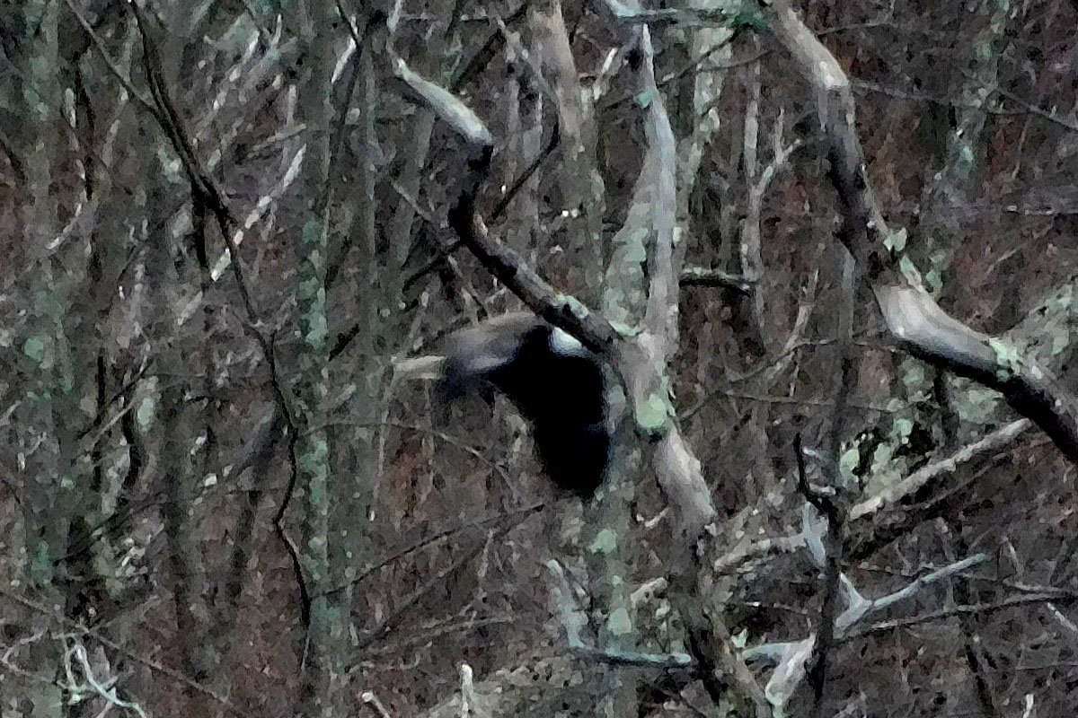
April 11, 2019 (5:27 PM): Adult Eagle in Flight
One of the adult eagles can be seen flying through some trees along Mohansic Lake. Unfortunately, the head of the eagle is hidden behind a limb in the foreground.

Slide 40
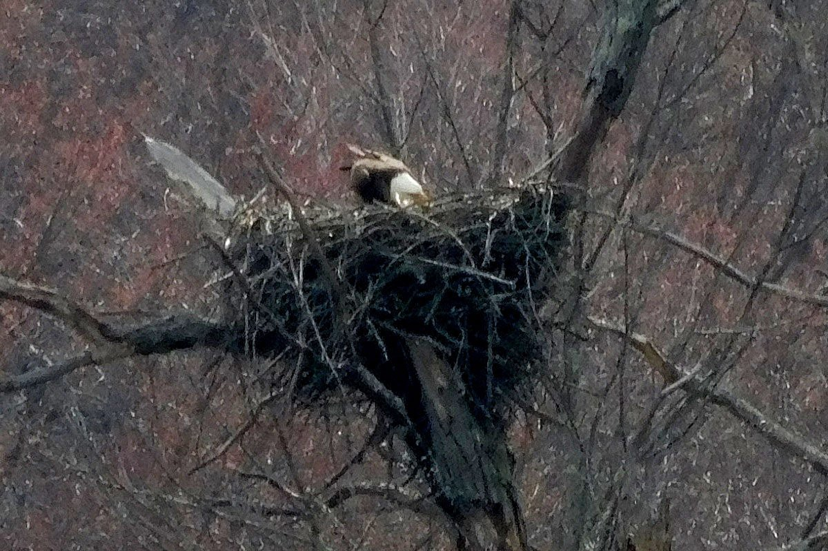
April 12, 2019 (3:42 PM):
One Adult Eagle Looking into the Nest
This adult eagle seems to be interested in something in the nest. In less than one minute, it will be joined by its partner carrying sticks. This eagle may be preparing the nest for the arrival of fresh building materials.

Slide 41
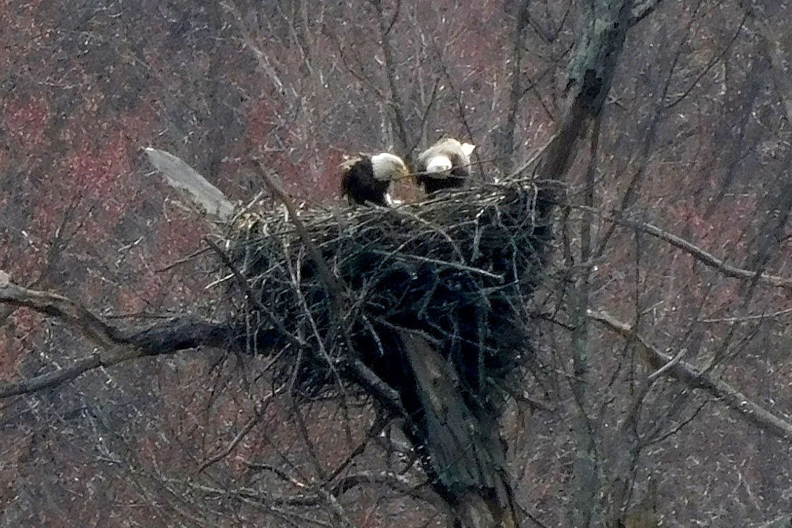
April 12, 2019 (3:42 PM):
Two Adult Eagles Building the Nest
These two eagles are working together to improve the nest. Eagle teamwork. This could indicate that the eggs have not yet hatched, but the parents sense that the eggs may be hatching soon and it is time to prepare the nest for the new inhabitants.

Slide 42
How to Make an Eagle
Mohansic Lake - FDR State Park Yorktown, NY
April 15 to April 30, 2019:
Down-covered Baby Eaglets (16 photos)

Slide 43
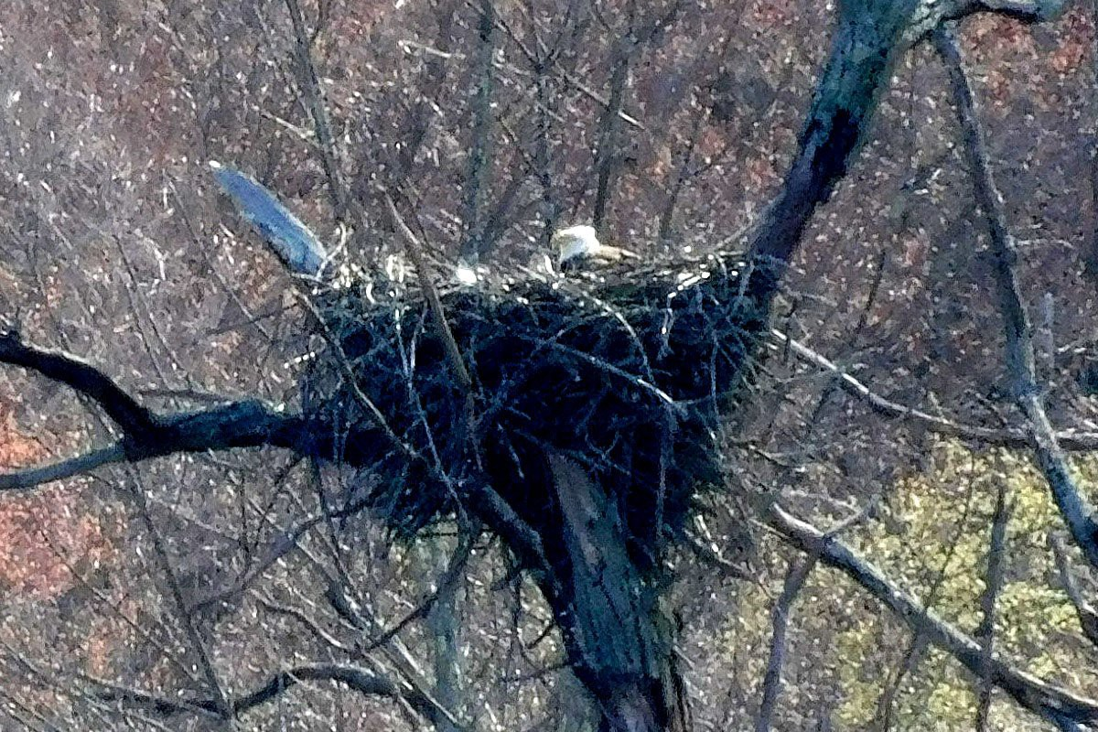
April 15, 2019: One Adult Eagle in the Nest with a New Hatchling Baby Eaglet
This the first shot of the newly hatched baby eaglet. Only the top of the head can be seen, covered in gray downy feathers. The downy feathers will be replaced by black feathers within a few weeks.

Slide 44
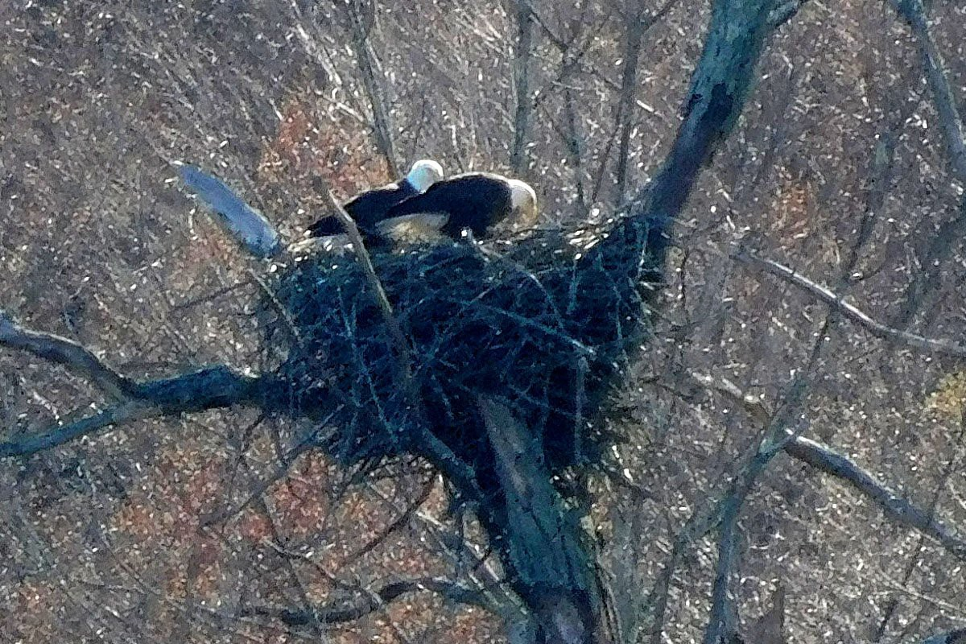
April 16, 2019 (4:53 PM): Two Adult Eagles on the Nest
By now at least one baby eaglet has hatched from its egg. Both parents are paying attention to something and one may be trying to feed the baby, which cannot be seen in this photo.

Slide 45
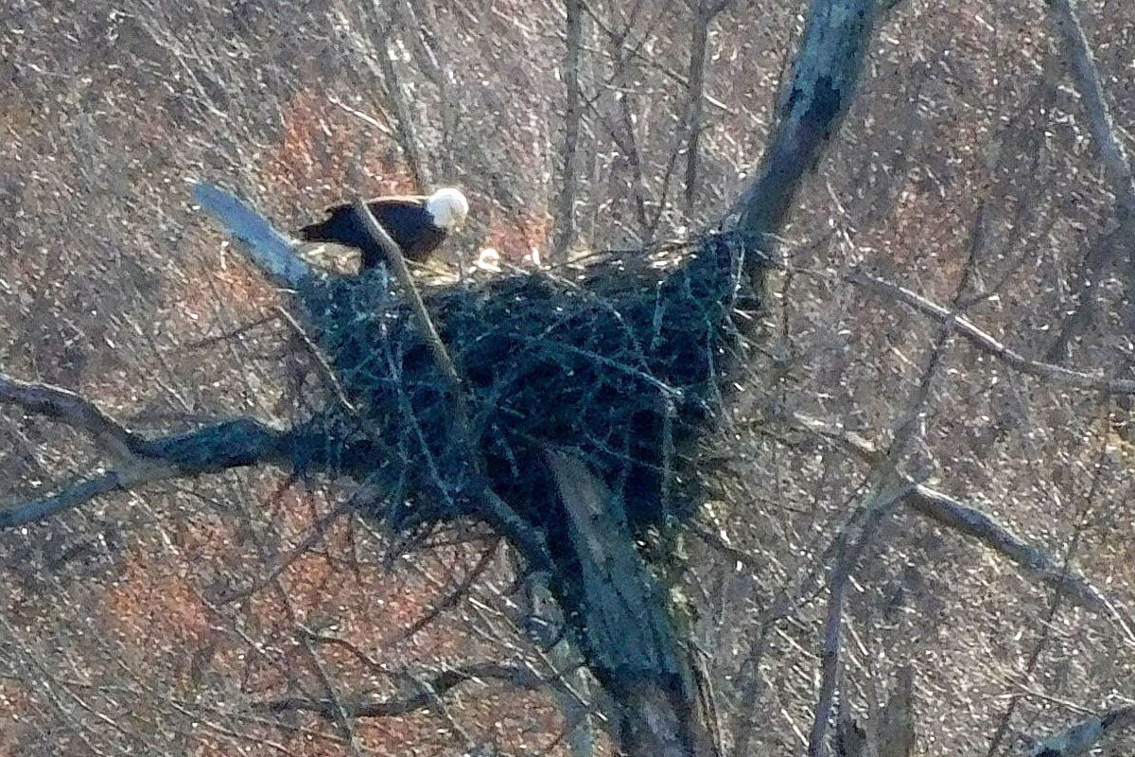
April 16, 2019 (5:03 PM): One Adult Eagle on the Nest and One Baby Eaglet in the Nest
A few minutes after the previous photo, one of the parents has flown off and the head of one tiny fluffy baby eaglet is clearly visible in front of the remaining parent eagle.

Slide 46
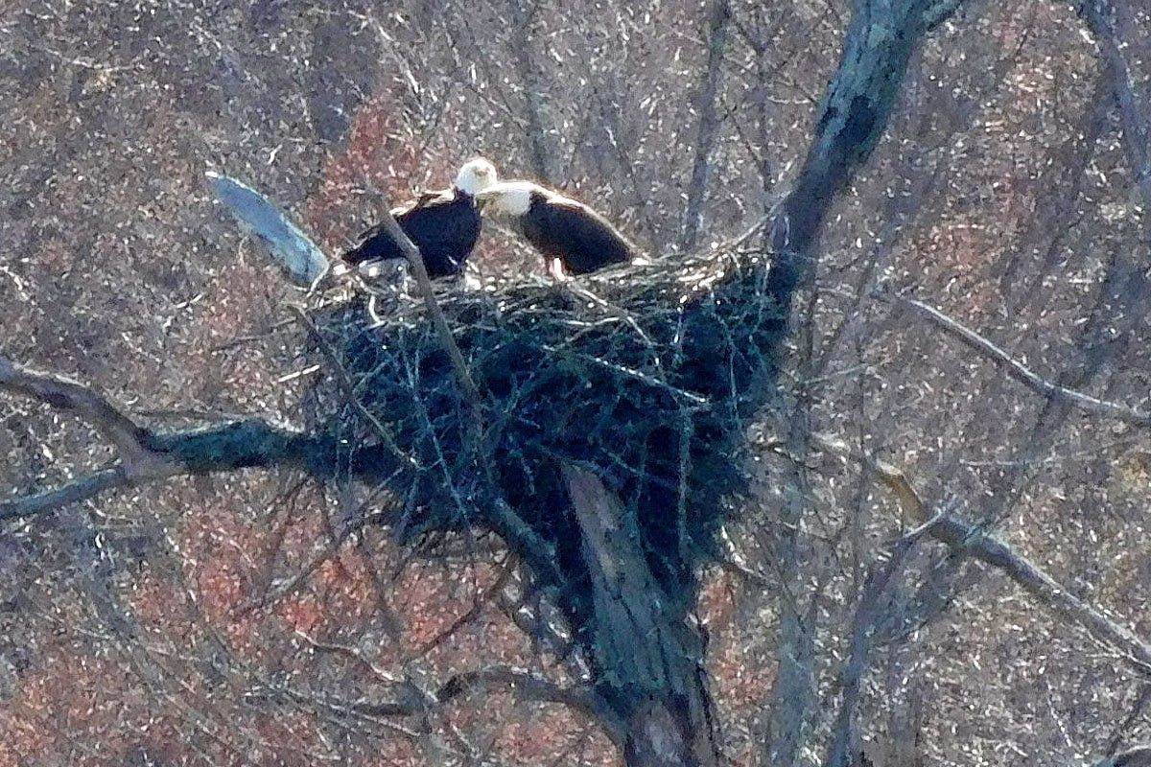
April 17, 2019 (3:50 PM): Two Adult Eagles on the Nest
Both of the adult eagle parents are on the nest, and one has an open beak. It looks like it was making a loud noise, It must be excited by the birth of the baby eaglet seen in the days before.

Slide 47
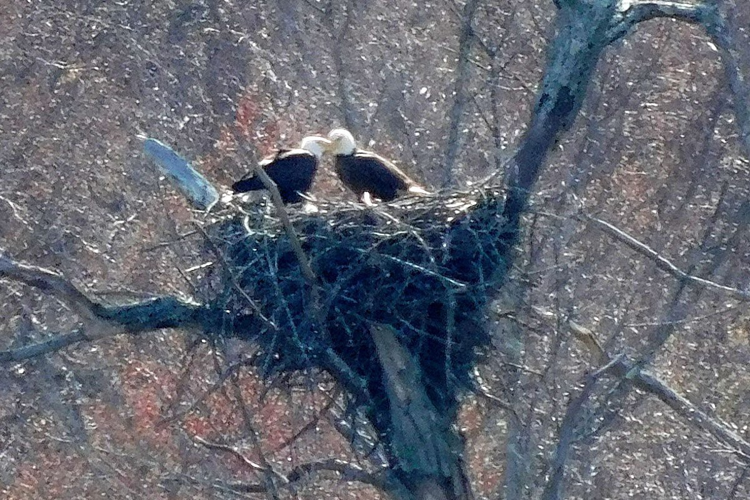
April 17, 2019 (3:50 PM): Two Adult Eagles on the Nest
The two adult eagle parents appear to be kissing or rubbing beaks. It looks like the love birds back in January. They may be pleased that at least one of the eggs has hatched. A second baby eaglet will be seen a few days later.

Slide 48
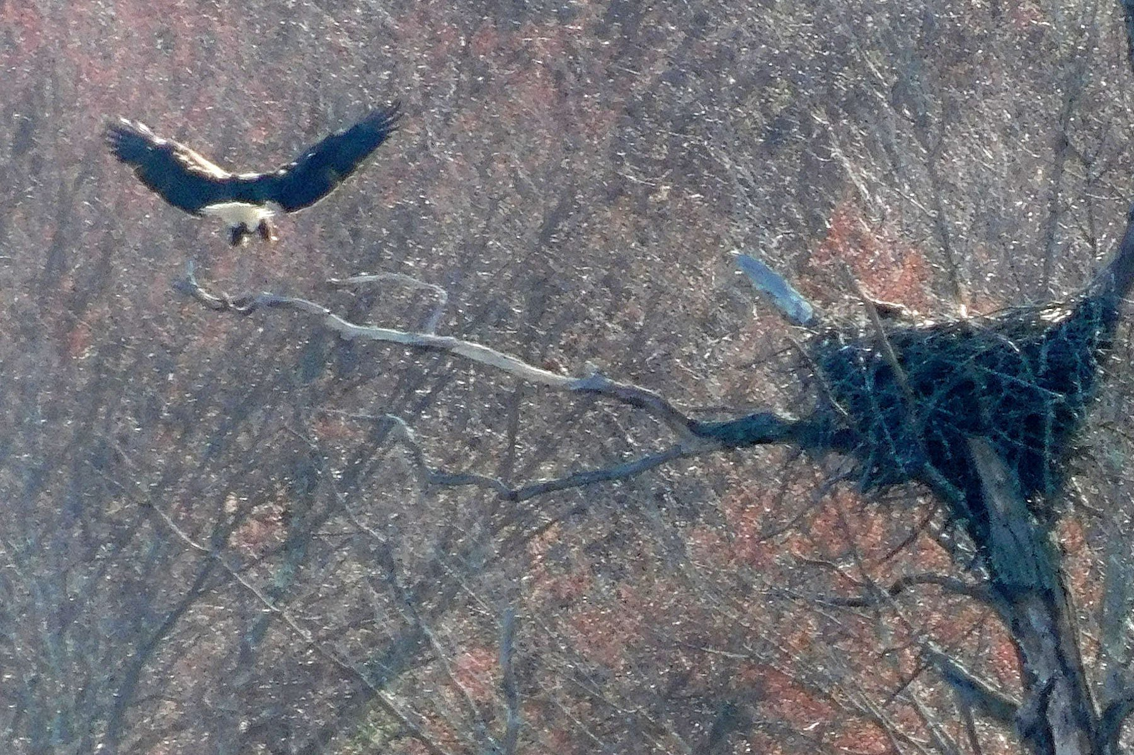
April 17, 2019 (4:47 PM):
One Adult Eagle Landing on the Branch
One adult eagle is coming in for a landing on the long branch to the left of the nest. Its wings and tail are spread out and the "landing gear" are down. No activity can be seen in the nest.

Slide 49
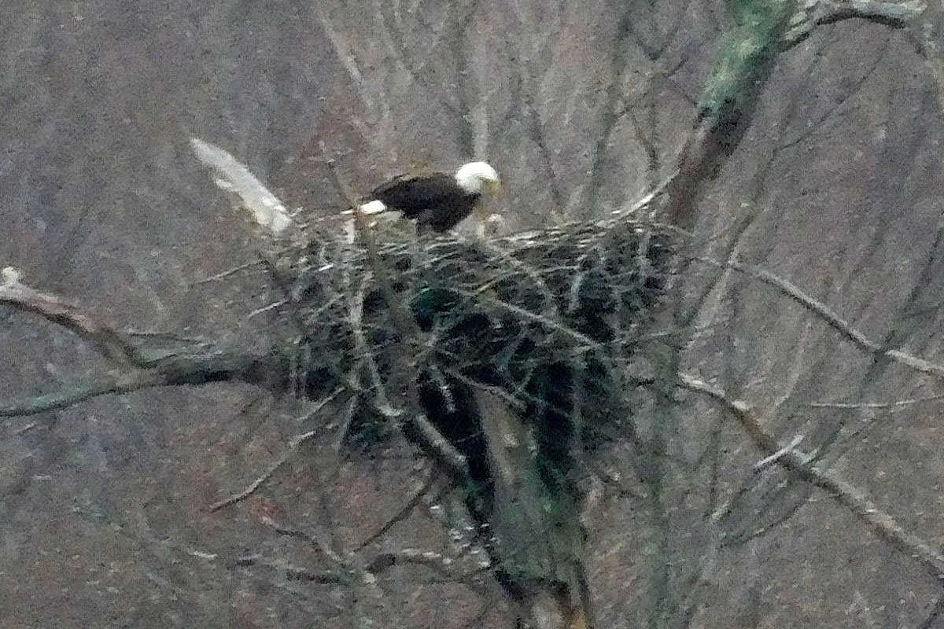
April 18, 2019 (5:19 PM):
One Adult Eagle with a Hatchling Baby Eaglet in the Nest
This is the third time the hatchling eaglet has been since April 15. It is still small and downy. The adult eagle parent is paying attention to the baby.

Slide 50
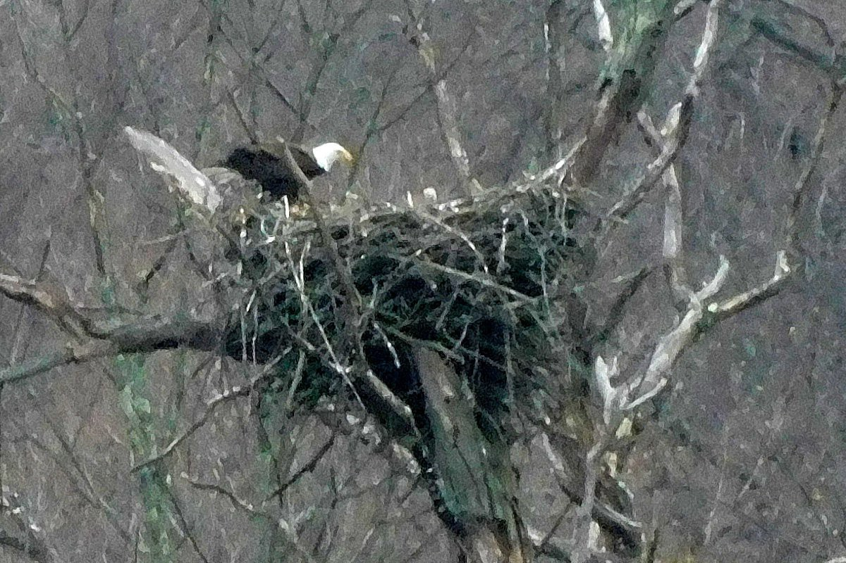
April 18, 2019 (5:36 PM):
One Adult Eagle with a Hatchling Baby Eaglet in the Nest
The hatchling eaglet is still small and downy. The adult eagle parent is paying attention to the baby. So far, there is still only one baby eaglet in this nest.

Slide 51
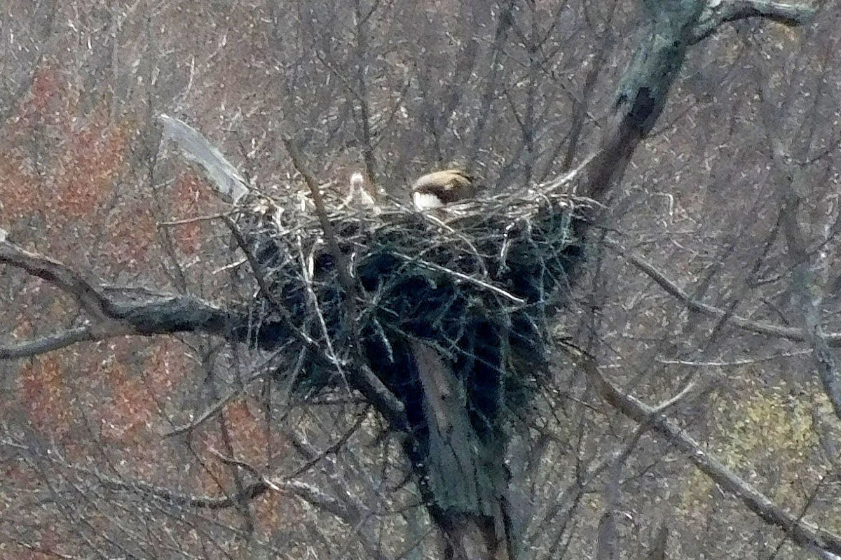
April 19, 2019 (2:52 PM): One Adult Eagle on the Nest with a Hatchling Baby Eaglet in the Nest
The baby eaglet is still small and downy, but it had moved upwards so the head neck and upper body can be seen for the first time. The adult eagle seems to be preoccupied with something else, with its head reaching down into the nest. It may be checking on the status of the other egg.
The second hatchling eaglet will not be seen until 4 days later, but there may be some activity in the nest.

Slide 52
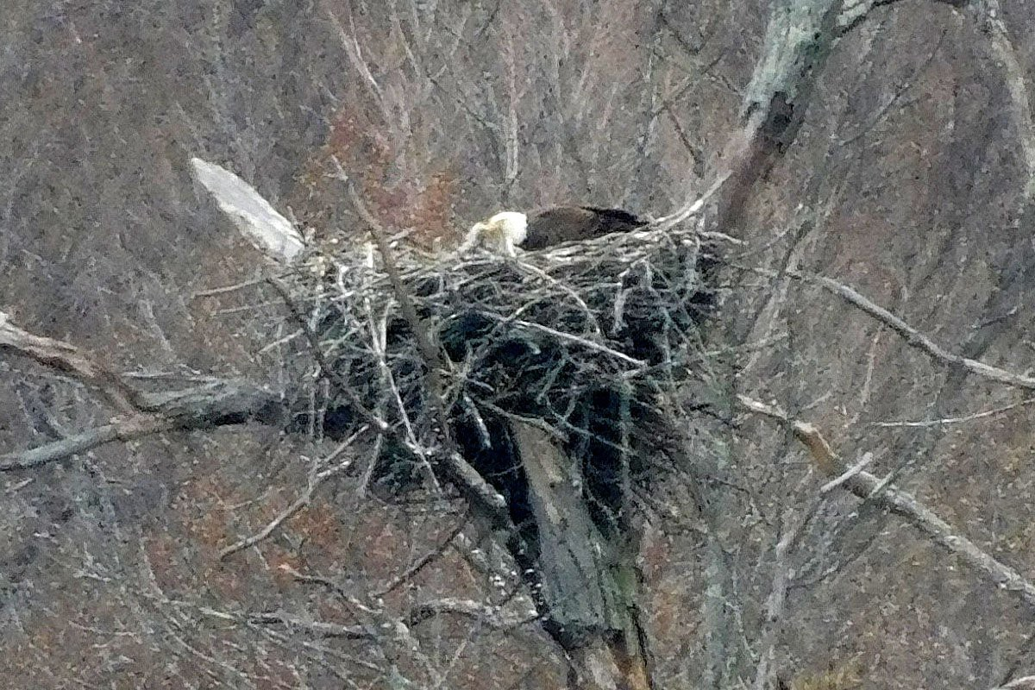
April 19, 2019 (2:54 PM): One Adult Eagle on the Nest with One Hatchling Baby Eaglet in the Nest
Still only one baby eaglet in the nest. The baby eaglet is still small and downy. The adult eagle may be feeding the eaglet. It is tempting to assign human-style gender roles to the parent eagles, but eagles do not operate just like people.

Slide 53
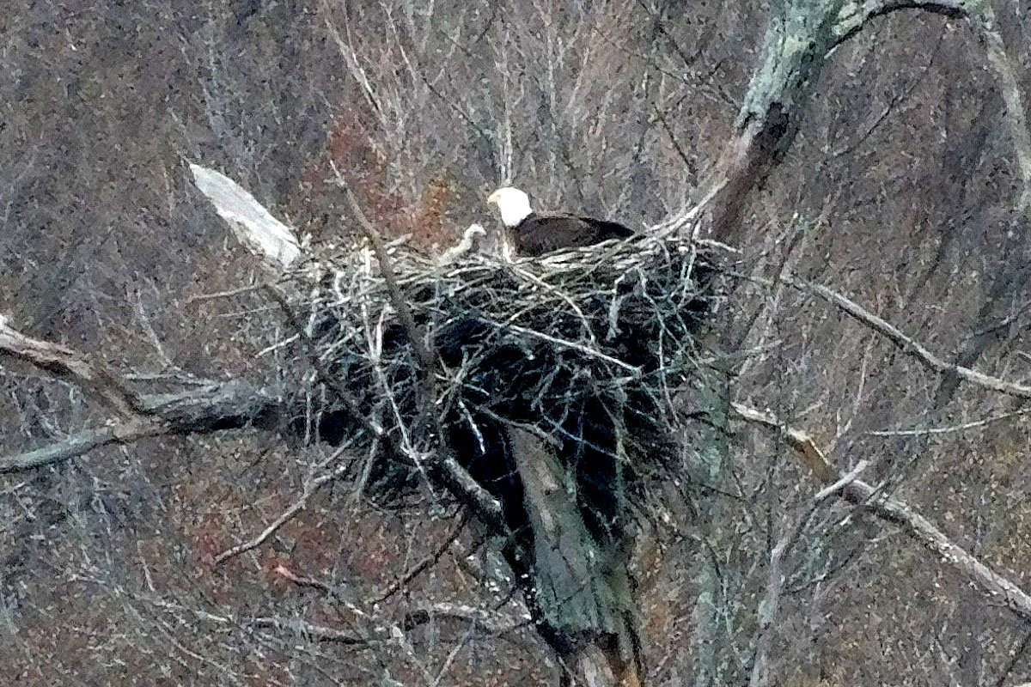
April 19, 2019 (2:54 PM): One Adult Eagle on the Nest with One Baby Eaglet in the Nest
Still only one baby eaglet in the nest. The baby eaglet is still small and downy. The adult eagle is paying attention to the baby.

Slide 54
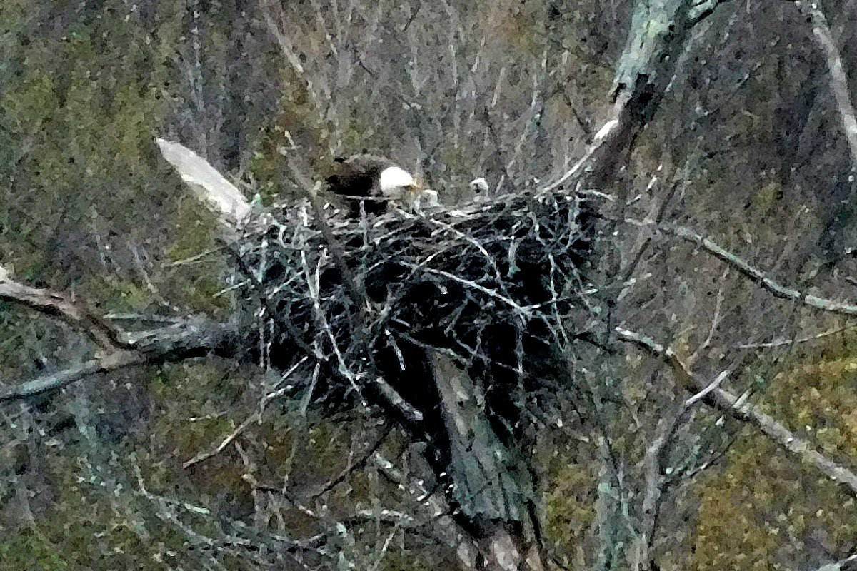
April 23, 2019: One Adult Eagle on the Nest with Two Baby Eaglets in the Nest
Now we can see two baby eaglets in the nest. downy.
Both are still small and

Slide 55
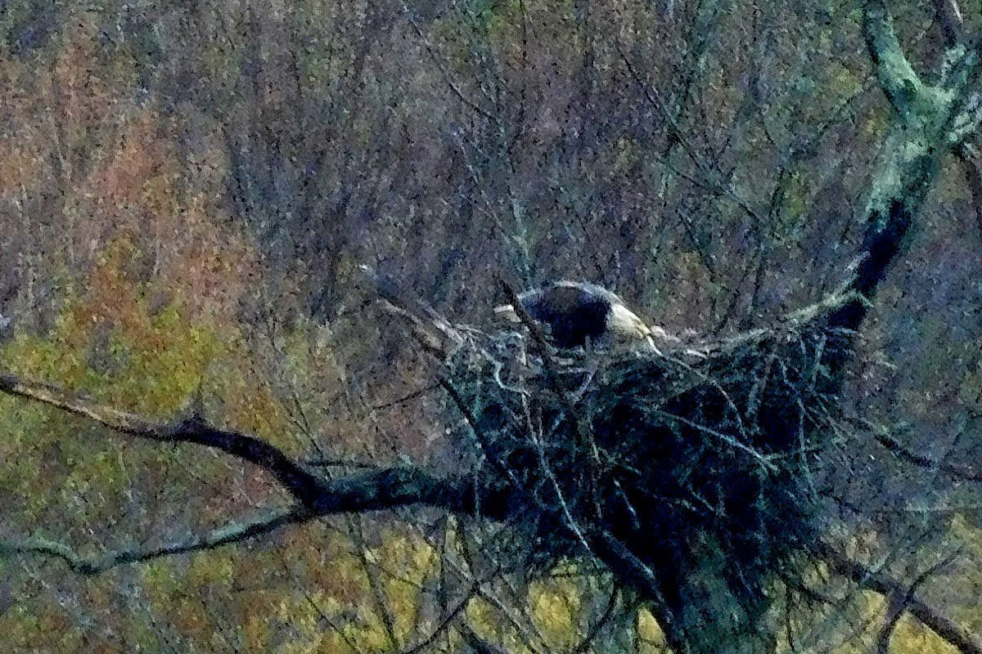
April 26, 2019:
An Adult Eagle
Shows Affection
to Two Baby
Eaglets in the Nest
An adult eagles appears to be rubbing beaks with the two small downy baby eaglets. Its head is turned to the side and its beak is slightly open. The adult does not seem to be feeding the babies. Instead, this seems to be a sign of affection.

Slide 56

April 28, 2019:
One Adult Eagle on the Nest with Two Baby Eaglets in the Nest
One adult eagle is attending to two small downy baby eaglets.

Slide 57

April 30, 2019 (4:41 PM):
One Adult Eagle on the Nest with Two Baby Eaglets in the Nest
The baby eaglets are still small and downy, but they seem to be getting larger and braver.

Slide 58

April 30, 2019 (4:43 PM):
One Adult Eagle on the Nest with Two Baby Eaglets in the Nest
One adult eagle supervising two baby eaglets. The color of the baby eaglets seems to be slowly getting darker. One baby seems to be braver then the other.

Slide 59
How to Make an Eagle
Mohansic Lake - FDR State Park Yorktown, NY
May 2 to May 29, 2019:
The Eaglets Grow and Develop (13 photos)

Slide 60

May 2, 2019: One Adult Eagle on the Nest with One Baby Eaglet in the Nest
One of the parents looks over the nest while one of the baby eaglets rises higher in the nest. This baby eaglet is getting bigger and its color is getting darker.

Slide 61

May 3, 2019: One Adult Eagle on the Nest with Two Baby Eaglets in the Nest
The adult eagle appears to be feeding one of the baby eaglets. Or else it may be delivering a lecture to the children.

Slide 62

May 4, 2019 (4:05 PM):
Two Baby Eaglets Alone in the Nest
With neither of the parents around, one of the baby eaglets bravely climbs higher in the nest. The other baby eaglet is more timid. Both eaglets are getting larger and darker.

Slide 63

May 4, 2019 (4:12 PM):
One Adult Eagle in the Woods
As the baby eaglets grow larger, the nest seems to be getting crowded. Until recently, at least one of the adult eagle parents would be in the nest at all times. Instead, the parents of the eaglets are spending more time perched in nearby trees overlooking Lake Mahopac. This one seems to be looking at the camera.

Slide 64

May 4, 2019 (6:06 PM):
One Adult Eagle Outside the Nest and Two Eaglets in the Nest
The baby eaglets are growing larger and darker. As the baby eaglets grow larger, the nest seems to be getting crowded. In this case, the adult parent eagle appears to prefer to perch near the nest, but outside, giving the baby eaglets more room to move around.
One of the eaglets seems bolder and climbs higher out of the nest, while the other eaglet seems to be more timid.

Slide 65

May 14, 2019: One Adult Eagle and Two Eaglets
Once again, the adult eagle prefers to be perched near the nest, but outside. The two eaglets in the nest have become much darker and essentially black, like juvenile eagles. The eaglet on the left appears to be braver than the timid one on the right.

Slide 66

May 16, 2019: Two Eaglets Alone in the Nest
The two young eaglets now have black feathers instead of gray down covering their bodies. The eaglet in the right is almost as big as the parents. The timid eaglet on the left may be similar in size, but this is harder to see because it is lower in the nest.

Slide 67

May 22, 2019: Two Eaglets Alone in the Nest
About five weeks after hatching, the eaglets are starting to stretch their wings.

Slide 68

May 24, 2019: One Adult Eagle and Two Eaglets in the Nest.
One of the eagle parents (on the left) may be delivering a supply of food to the two eaglets. Both eaglets are facing the parent.
Five weeks after hatching, the eaglets are now just as big as the parents.

Slide 69

May 27, 2019 (7:07 PM): Two Eaglets Alone in the Nest, One with Its Wings Open
The older bolder eaglet is learning how to flap its wings while the timid sibling watches.

Slide 70

May 27, 2019 (7:09 PM):
Two Adult Eagles Perched on a Tree
The two adult eagle parents are meeting each other about 100 feet from the nest. Both have their shoulders hunched, and the one on the right appears to be passing a small piece of food to its partner on the left

Slide 71

May 28, 2019: One Eaglet Alone in the Nest
This must be the braver eaglet. It is now all black like a juvenile eagle, and it is just as large as its parents. Its sibling must be lower in the nest, or hidden behind this eaglet.

Slide 72

May 29, 2019: Four Eagles in the Nest
The eagles' nest is getting crowded, with two adult eagles (the parents) and two all black juvenile eaglets (the children).
We can see the white tail of one of the adult eagles facing away from the camera, and the white head of the other adult eagle on the far side of the nest, bent over with its head down. The two black juvenile eaglets are located between their parents.
The adults must have come to the nest to bring some food for the eaglets.

Slide 73
How to Make an Eagle
Mohansic Lake - FDR State Park Yorktown, NY
June 1 to August 1, 2019:
The Eaglets Learn to Fly (23 photos)

Slide 74

June 1, 2019 (7:01 PM):
Two Adult Eagles, One Taking Off
One of the adult eagles has just taken off from a perch near its partner. The "landing gear" point to the back and the wings are pushing hard. The stripes on its head may be the result of sunlight passing through some feathers on a wing.

Slide 75

June 1, 2019 (7:01 PM): Adult Eagle About to Land
The adult eagle is about to land on a horizontal branch directly below its current location. Its "landing gear" point vertically downward and the wings and tail appear to be applying the brakes.

Slide 76

June 1, 2019 (7:02 PM):
Two Eaglets Alone in the Nest, One with Wings Open
The bold eaglet is practicing the use of its wings, spreading its wings slowly, but not really flapping. The timid eaglet is in a horizontal orientation next to the bold eagle.

Slide 77

June 2, 2019 (6:24 PM):
Eaglet with Wings Spread Wide Open
The bold eaglet is stretching its wings with its back to the camera. The timid eagle, on the left side, is still not trying to exercise its wings.

Slide 78

June 2, 2019 (6:24 PM):
Eaglet with Wings Spread Wide Open
The bold eagle is stretching its wings more than ever. The timid eagle is either hidden behind the body of the bold eagle, or it has retreated deep into the nest.

Slide 79

June 12, 2019 (4:27 PM):
Eaglet with Two Feet in the Air
The bold eaglet has managed to flap its wings hard enough to lift its feet above the nest. Meanwhile, the timid eaglet simply stands on the rim of the nest and watches,

Slide 80

June 12, 2019 (4:27 PM):
Eaglet with Wings Spread Wide Open
The bold eaglet continues to exercise its wings while the timid eagle does nothing.

Slide 81

June 12, 2019 (4:29 PM):
Eaglet with Wings Spread Wide Open
Once again, the bold eaglet spreads its wings as the timid eagle watches passively.

Slide 82

June 13, 2019: One Adult Eagle and Two Eaglets
Two eaglets, the children, face an adult eagle, one of their parents. The parent eagle appears to be giving a lecture to the children. "Look, we will all be out of here in a short time, so you had better learn how to fly!"

Slide 83

June 17, 2019: Two Eaglets Alone in the Nest
The eaglet on the left is facing to the left with its wings spread. The larger eaglet on the right looks the other way. The eaglet on the left might be the timid one finally trying to figure out how to operate its wings, after a warning from one of its parents.

Slide 84

June 18, 2019: One Eaglet Perched Over the Nest
The bold eaglet had made a short hop of a flight to mount the broken branch on the left side of the nest. Once again, the timid eaglet simply sits there and watches.
This is the first evidence of an ability to fly a short distance, but the eaglet is still limited to points in or close to the nest.

Slide 85

June 20, 2019: Two Eaglets in Haze
It is a foggy day, but both eaglets remain close or on the nest. The eaglet on the left, the bold eaglet, is perched slightly outside the nest, while its timid sibling remains safely on the nest.

Slide 86

June 24, 2019: Both Eaglets Out of the Nest
Both eaglets are seen out of the nest for the first time. One eaglet, probably the bold eaglet, is perched on a branch of the branch on the left side of the nest. The other eaglet is above the nest to the right, where it is partly hidden.
In subsequent photos, the average distance between the eaglets and the nest and beteen each other increases steadily as the eaglets' dependence on the nest fades away.

Slide 87

June 26, 2019: Eaglet with Wings Up
The eaglets are back in the nest. One of this eaglets is stretching its wings while the other eaglet remains passive. Stretching the wings like this may improve its ability to fly.

Slide 88

June 29, 2019: Two Eaglets Out of the Nest
Once again we find both eaglets out of the nest. In this case, we find the timid eaglet perched over the nest while the bold eaglet is perched out on a limb with no nest below it.

Slide 89

June 30, 2019: Two Eaglets Out of the Nest
The bold eaglet on the left is very close to where it was the day before. The timid eaglet has gotten braver and moved out to a perch closer to its sibling.
The eaglets seem to be taking the lecture of June 13 seriously.

Slide 90

July 8, 2019: Eaglet with Wings Open on the Left Branch
It looks like this eaglet has just landed on the long branch on the left side of the nest. It is showing patterns of light and dark feathers on the undersides of its wings and tail.
The two eaglets seem to be moving independently so now we tend to see only one or the other, but not both in the same place.

Slide 91

July 9, 2019: One Adult Eagle on Mohansic Lake
The parents of the eaglets are not seen very often anymore, and we never see both of them at the same time. It is likely that one (the male?) has already left the area and headed north to its summer home. This eagle may be hanging around in order to make sure the children also head north.
This eagle appears to be perched with its feet underwater. Soon after this shot was taken it moved over to a part of the fallen tree that is out of the water,

Slide 92

July 12, 2019: One Juvenile Eagle Landing on the Left Branch
This branch is close to the nest which can be seen on the right. The wings of this eaglet have grown very large and capable of long flights. By now it is more appropriate to refer to this as a juvenile eagle rather than an "eaglet".
Its stronger sibling may have already began its northward migration. The remaining eaglet only needs is a little more practice and some prodding from the parent that has remained nearby before it heads off to somewhere it has never seen before.

Slide 93

July 20, 2019: One Eaglet and One Adult Eagle
One adult eagle (parent) and one juvenile eaglet (child) are perched on a dead tree overlooking Mohansic Lake. The former eaglet is now a juvenile eagle and it is no longer interested in the old nest. It needs to head north but it may be intimidated.
The parent may be trying to convince the juvenile eagle that it time to get its show on the road and head north, and the parent will then show the juvenile how to do this.

Slide 94

July 28, 2019: One Adult Eagle Perched in a Tree
This the last shot of an adult eagle near Mohansic Lake this season. There is no longer any interest in the nest. This eagle probably headed north to its summer home soon after this photo was captured.

Slide 95

August 1, 2019: The Juvenile Eagle on Mohansic Lake
A lonely juvenile eagle walks on some floating vegetation looking for something to eat. A Canada goose swims by in the foreground.
This must be the timid eaglet. Both parents and its sibling have already left the area. They may have headed north to the Adirondacks or Quebec. It is time for Junior to follow his family to their summer haunts.
This was the last time any members of this family of eagle were seen in FDR State Park this season.
--- The End ---

